Slide 1
John 13:1-17

Slide 2
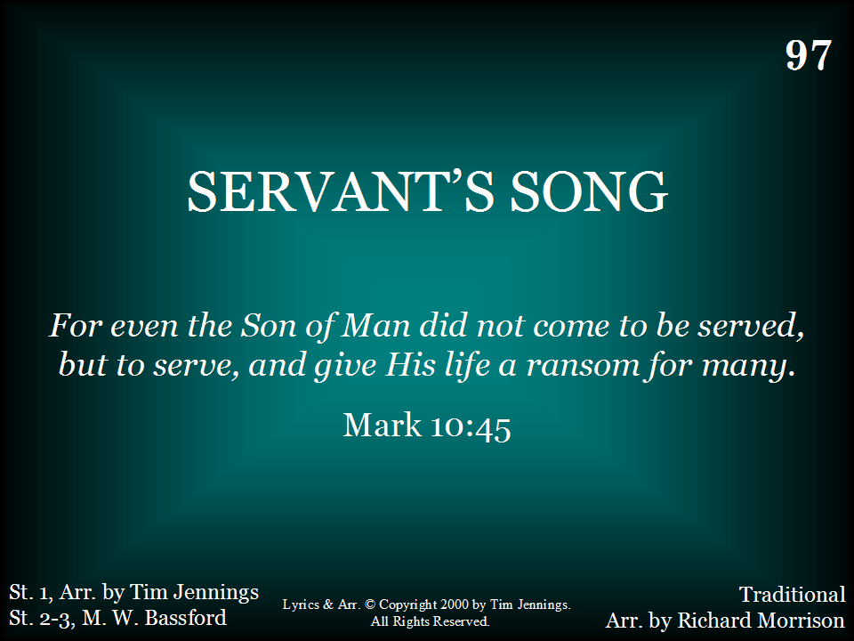
Supplement 18

Slide 3
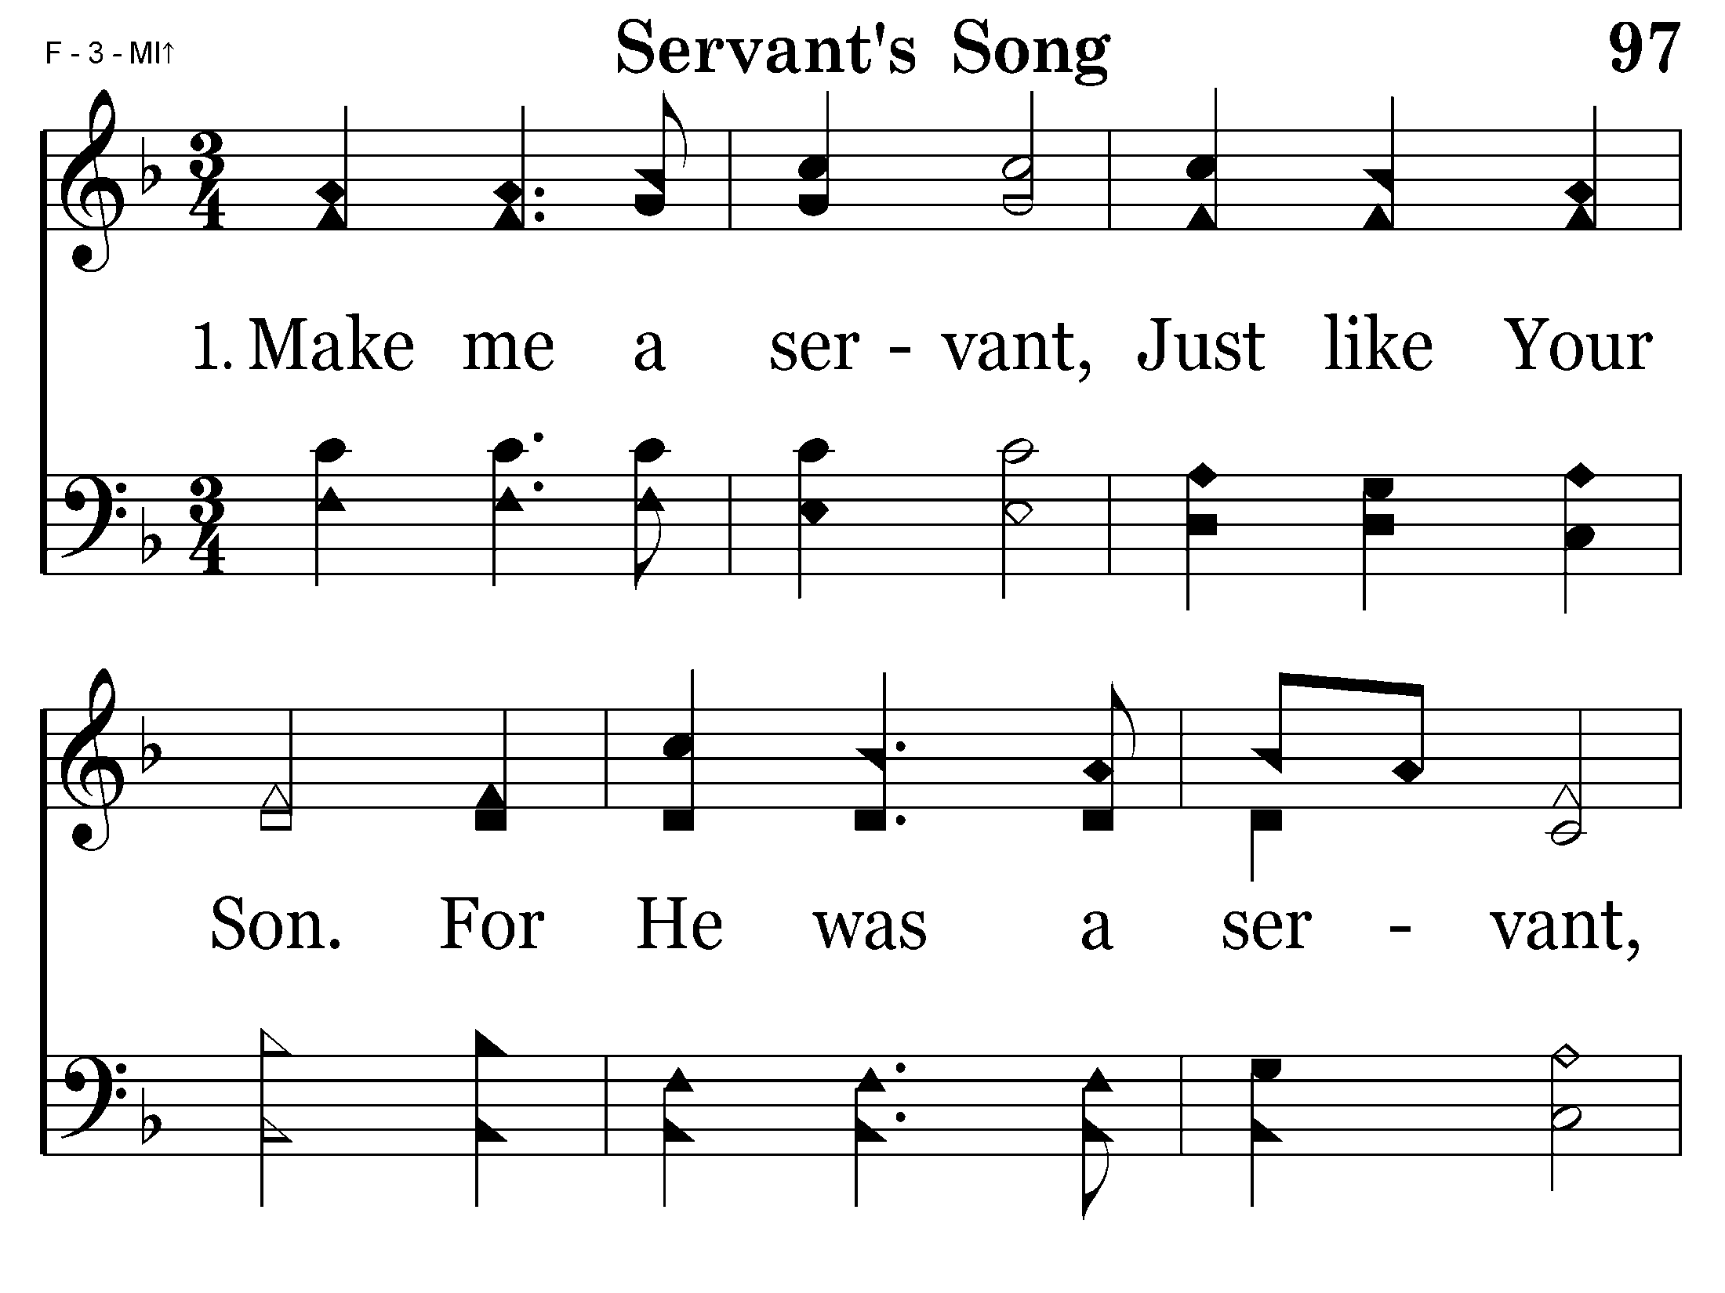

Slide 4
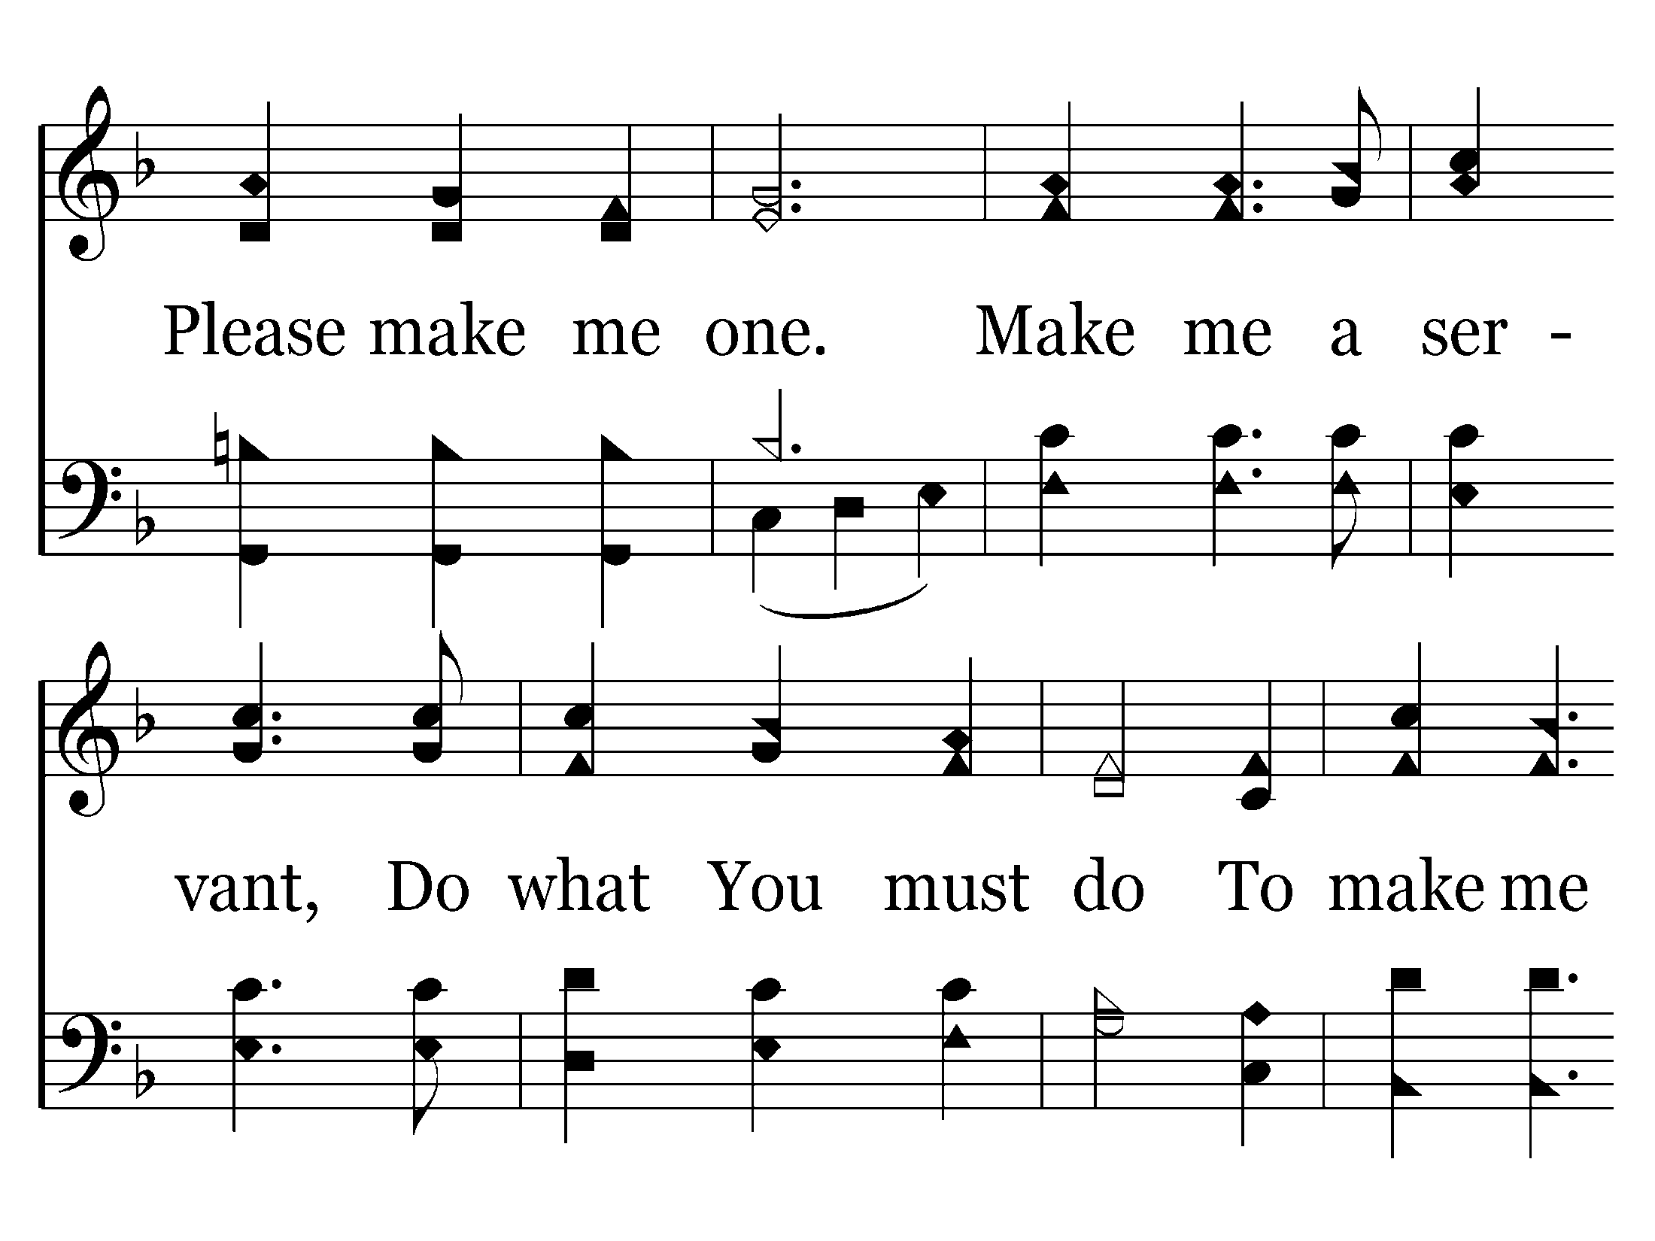

Slide 5
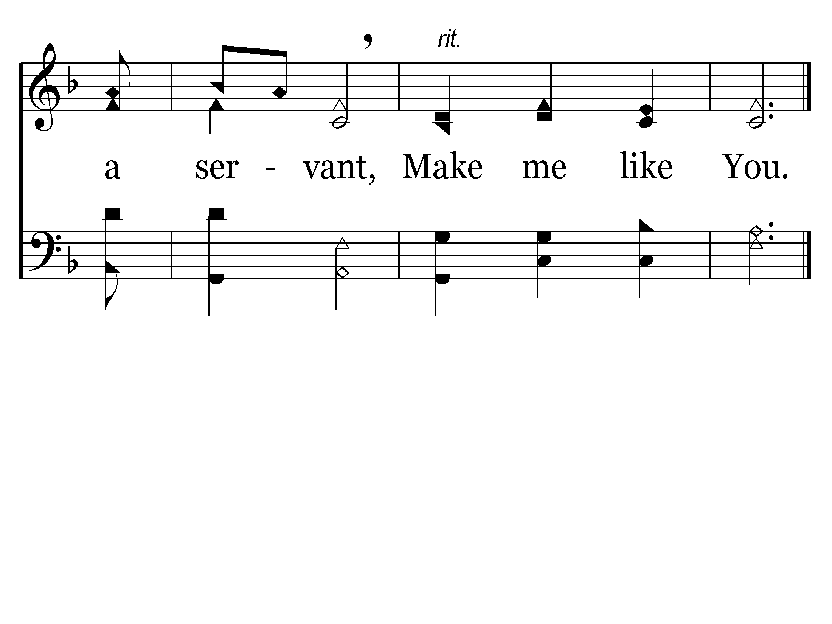
End of Verse 1

Slide 6
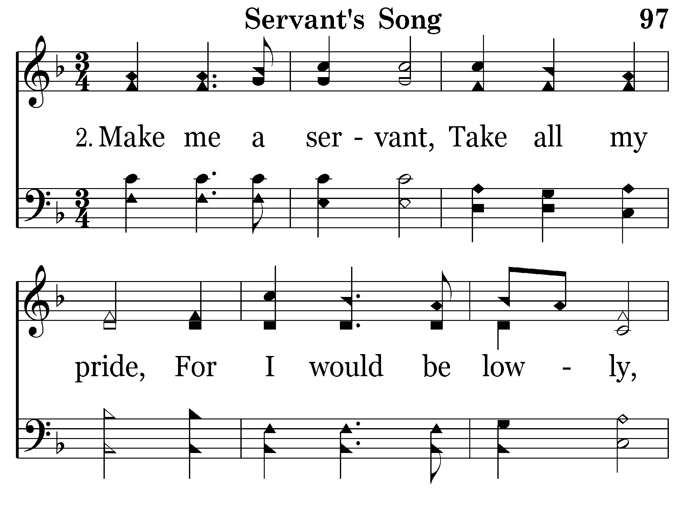

Slide 7
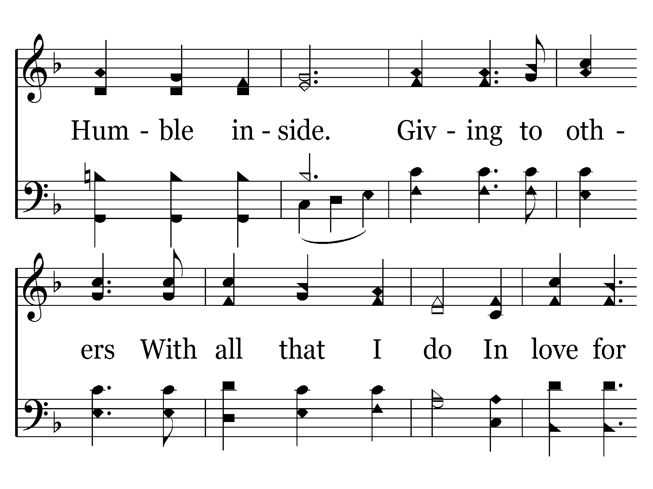

Slide 8
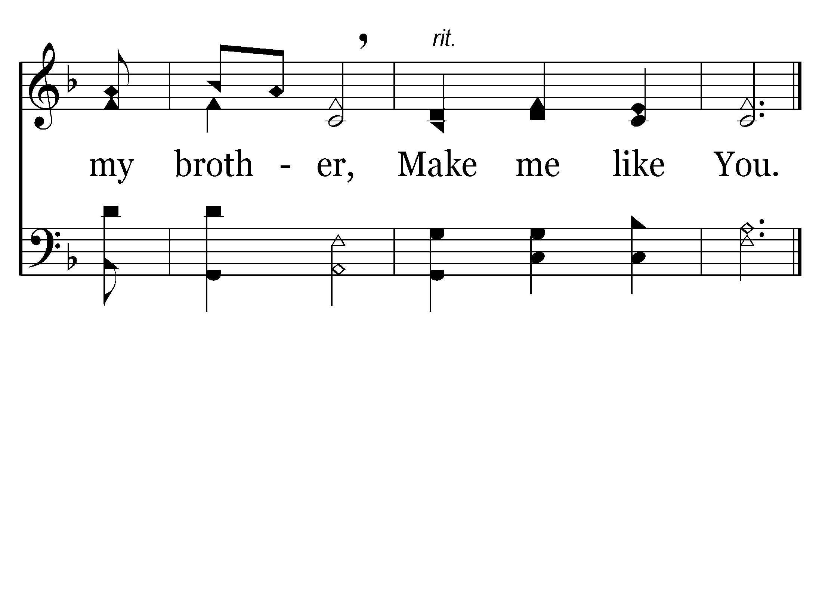
End of Verse 2

Slide 9
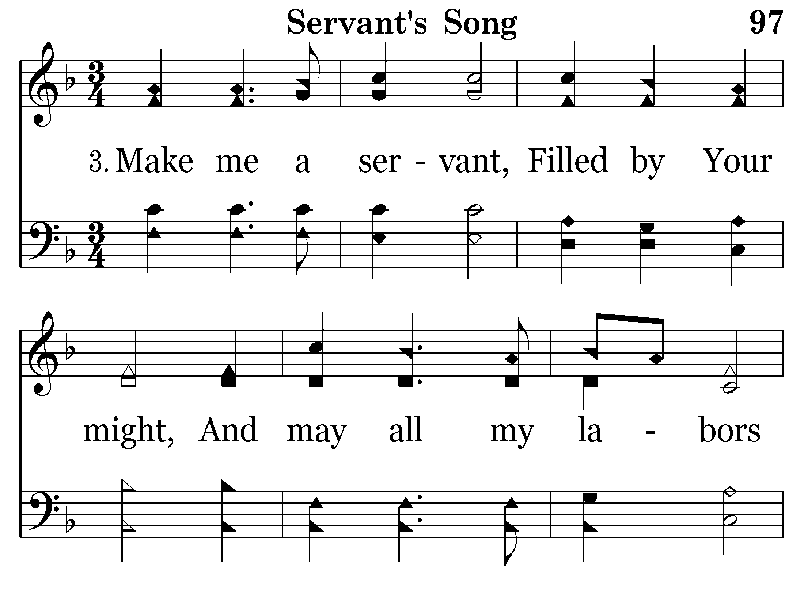

Slide 10
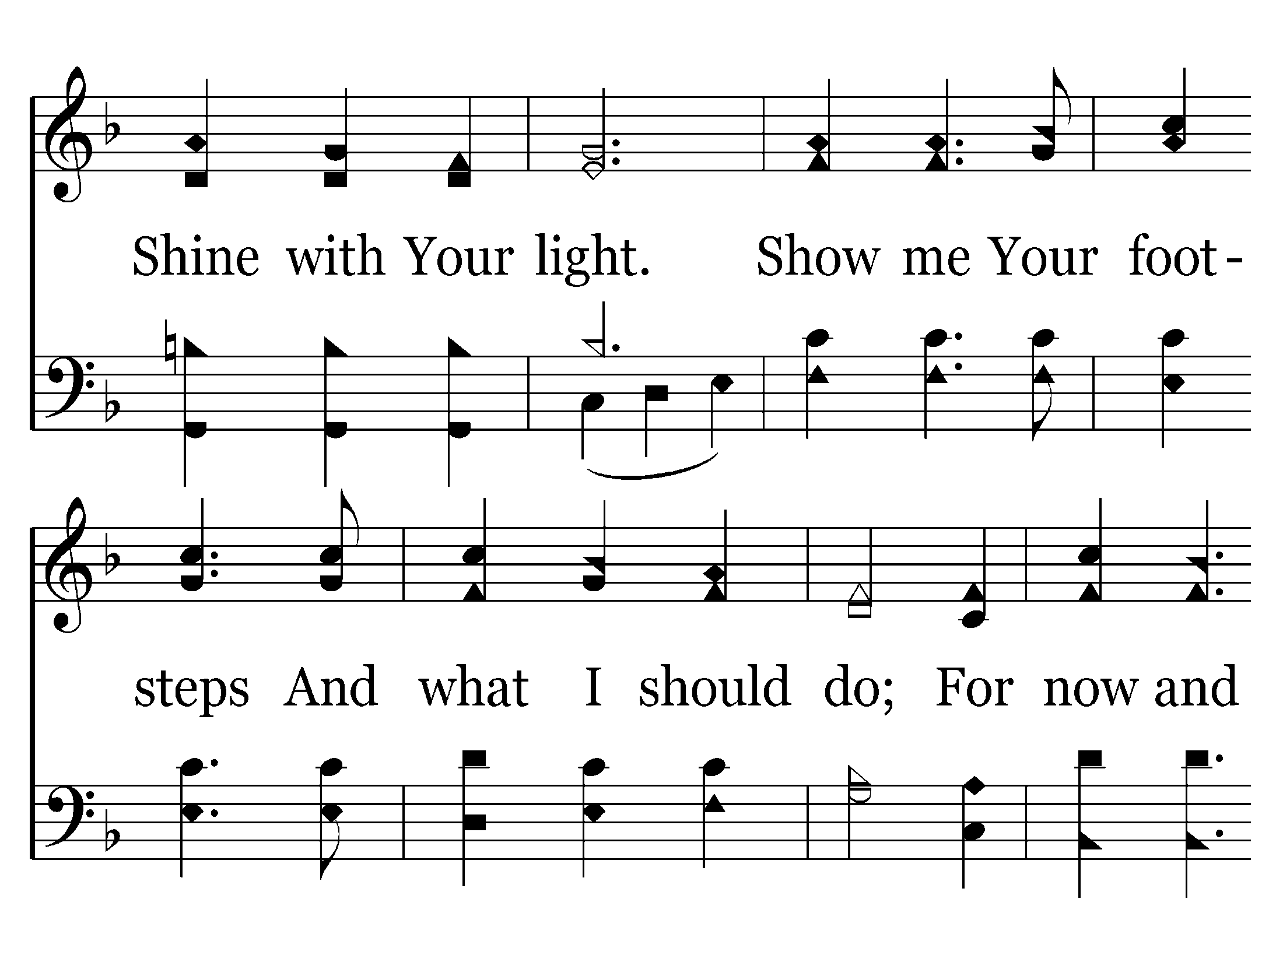

Slide 11
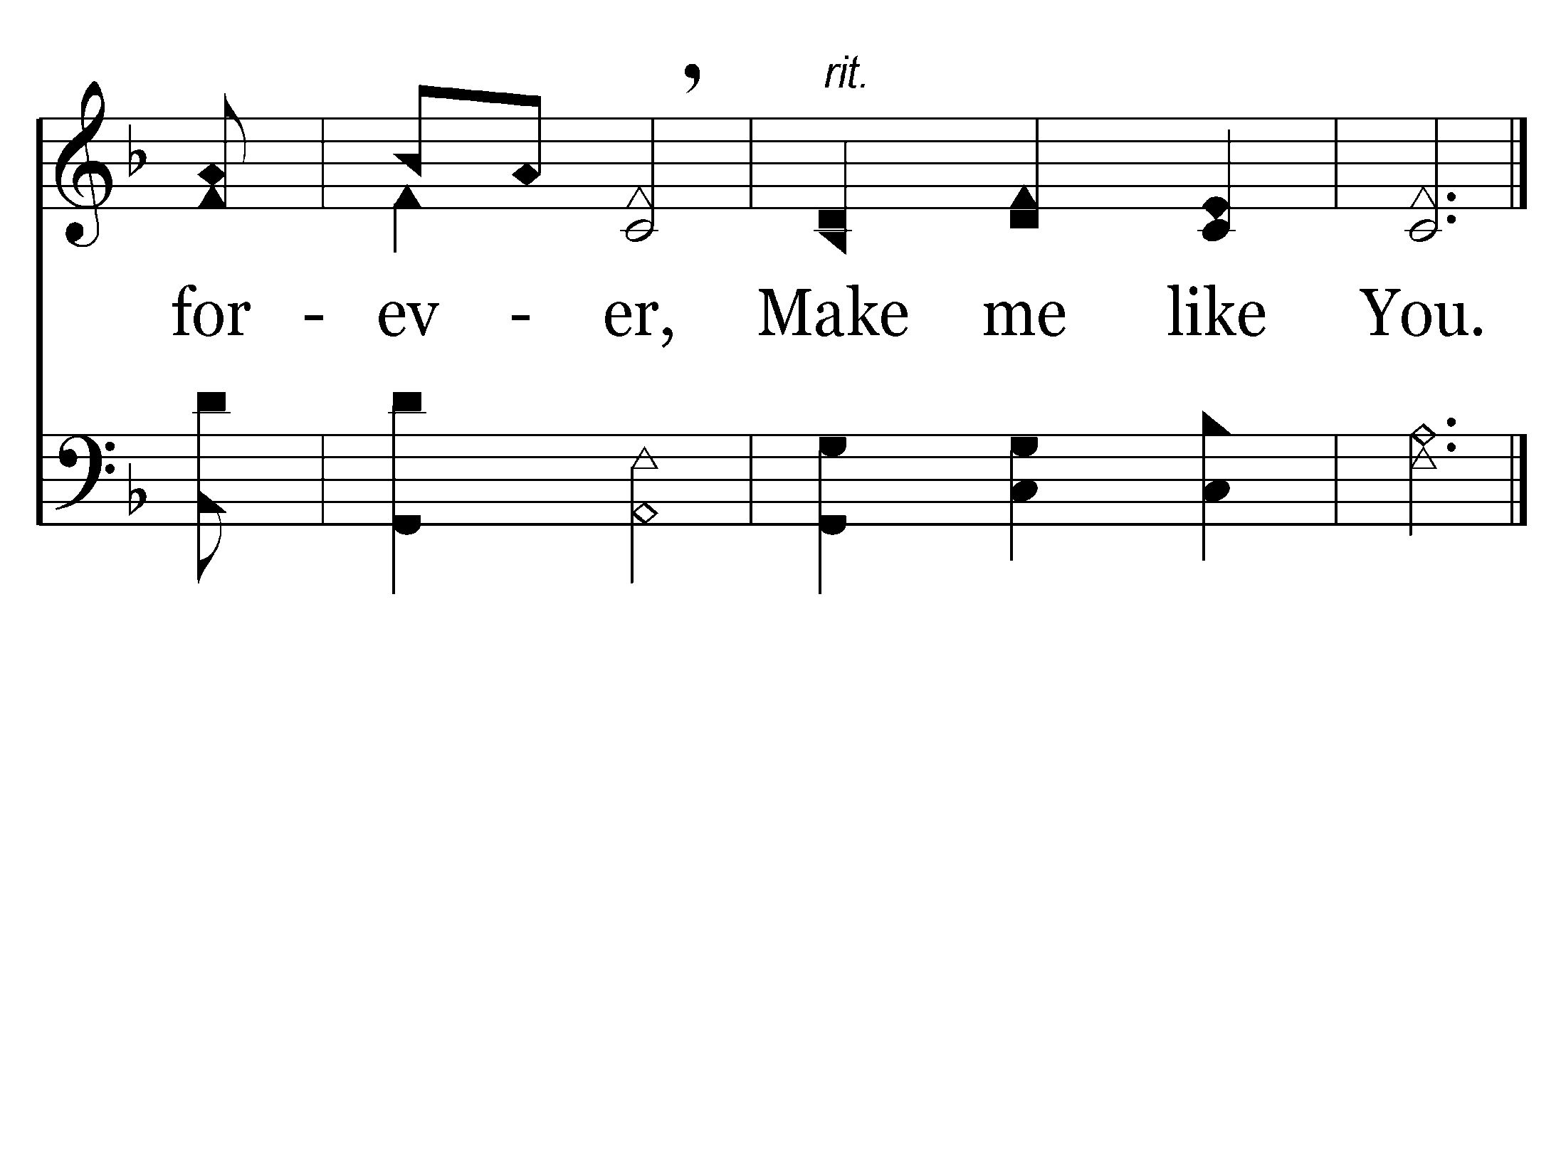
End of Song

Slide 13
THE HEART OF A SERVANT
John 13:1-17

Slide 14
Mark 9:33-35
33 Then He came to Capernaum. And when He was in the house He asked them, "What was it you disputed among yourselves on the road?"
34 But they kept silent, for on the road they had disputed among themselves who would be the greatest.
35 And He sat down, called the twelve, and said to them, "If anyone desires to be first, he shall be last of all and servant of all.”

Slide 16
THIS TYPE OF SERVICE
Doesn’t WORRY about MY RIGHTS!

Slide 17
Ephesians 6:5-7
5 Bondservants, be obedient to those who are your masters according to the flesh, with fear and trembling, in sincerity of heart, as to Christ;
6 not with eyeservice, as men-pleasers, but as bondservants of Christ, doing the will of God from the heart,
with good will doing service, as to the Lord, and not to men,

Slide 18
Romans 12:10-11
10 Be kindly affectionate to one another with brotherly love, in honor giving preference to one another;
11 not lagging in diligence, fervent in spirit, serving the Lord;

Slide 19
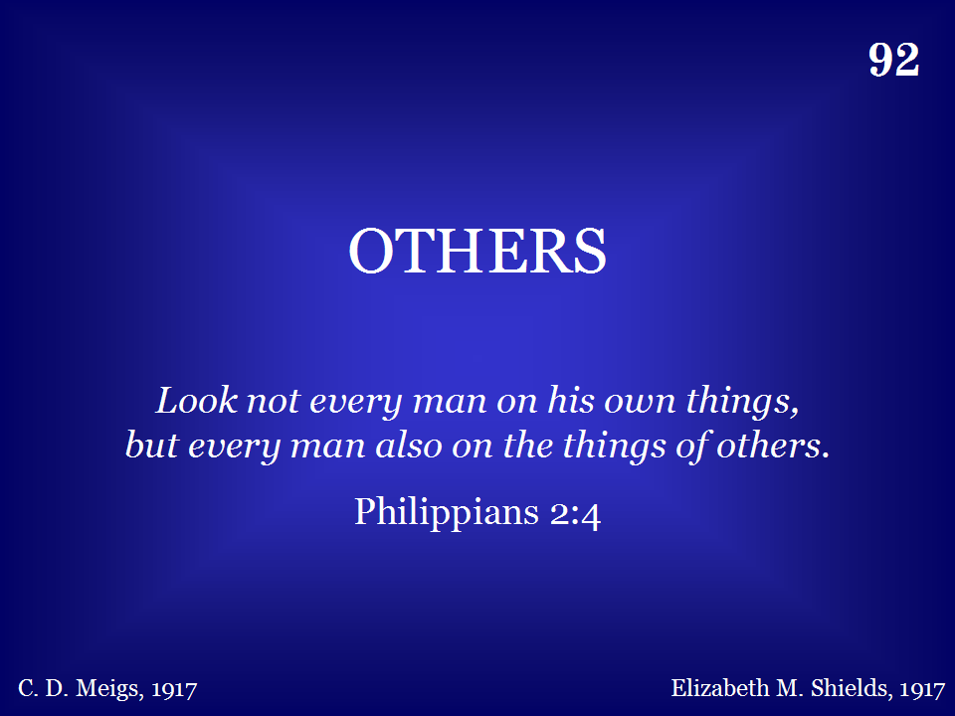

Slide 20
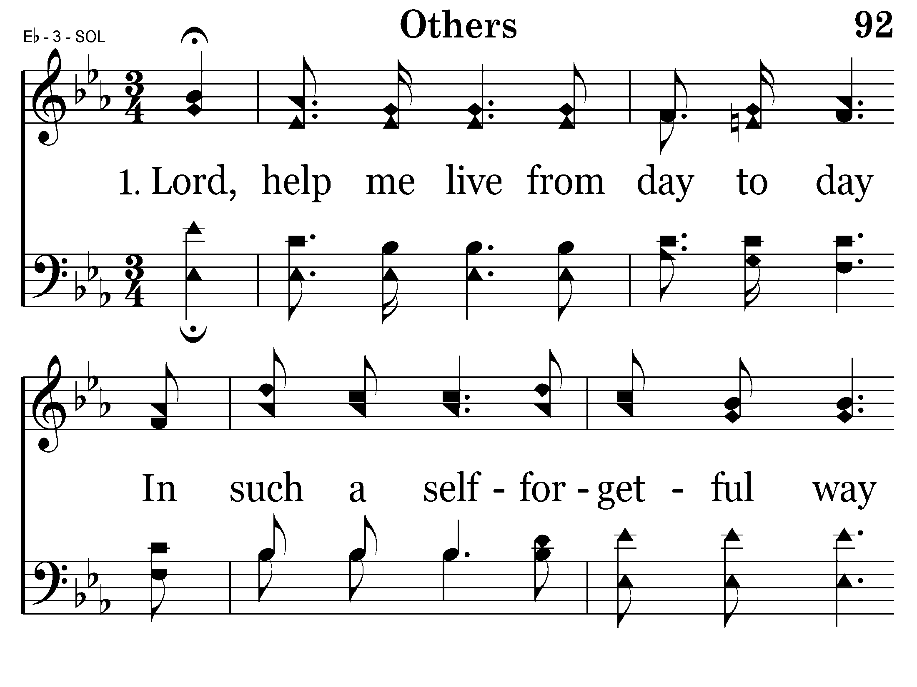

Slide 21
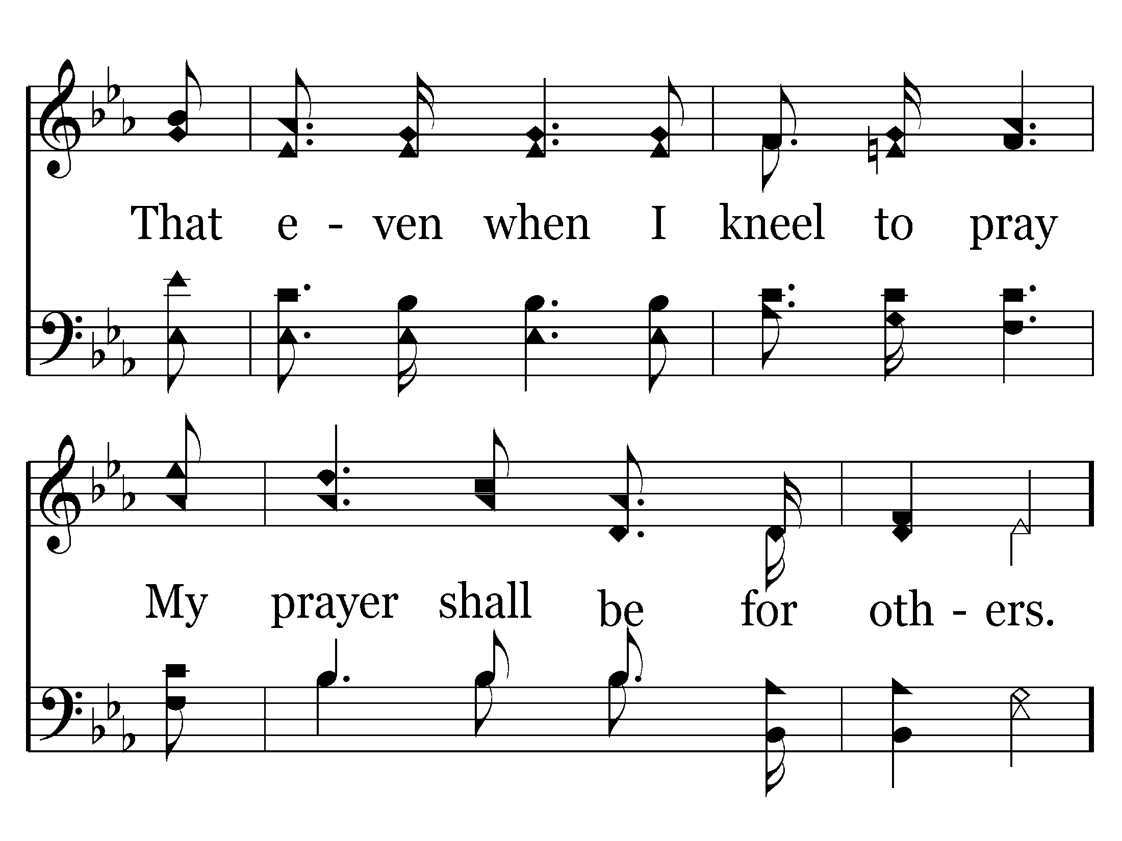
Go back to verse 2
End of Verse 1

Slide 22
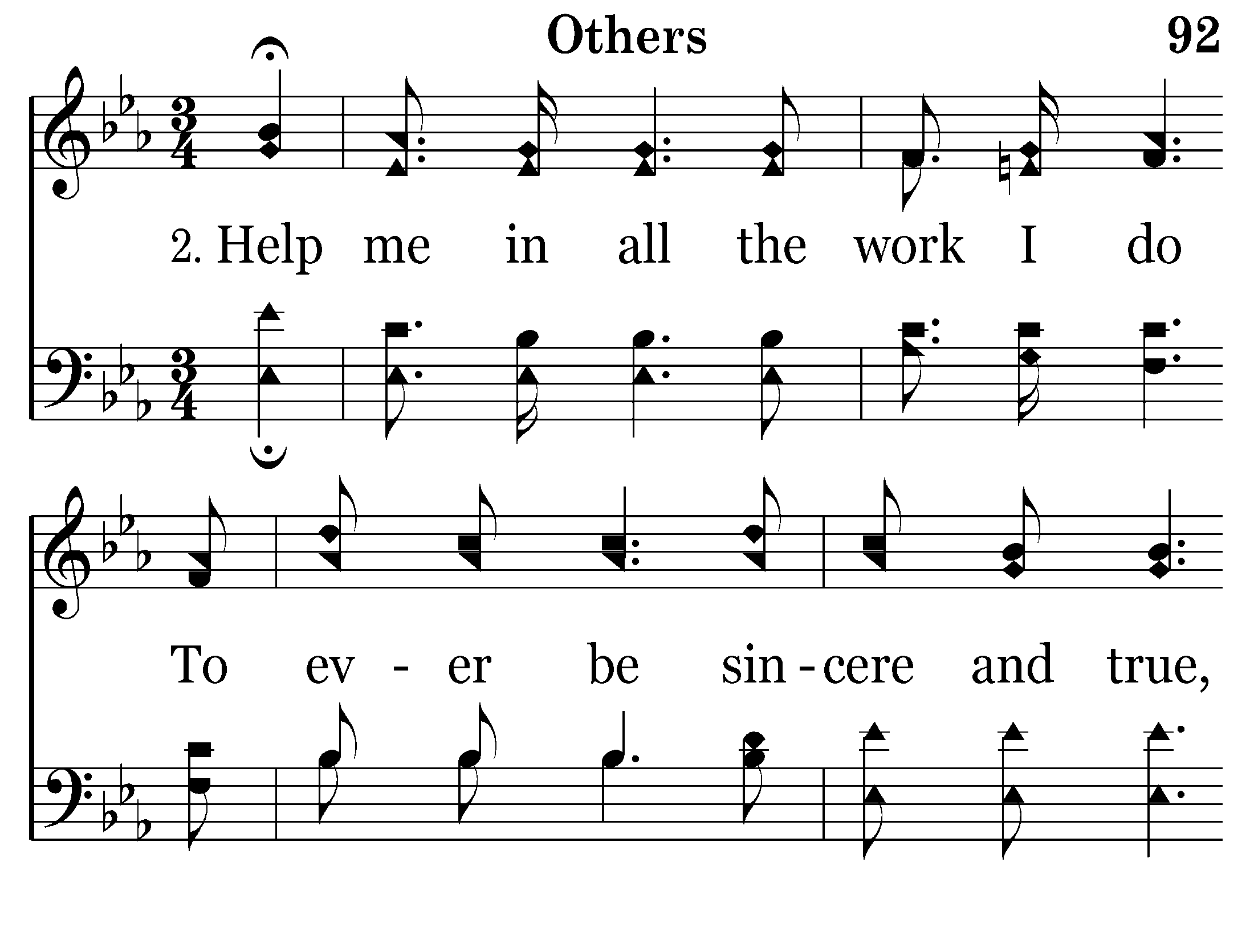

Slide 23
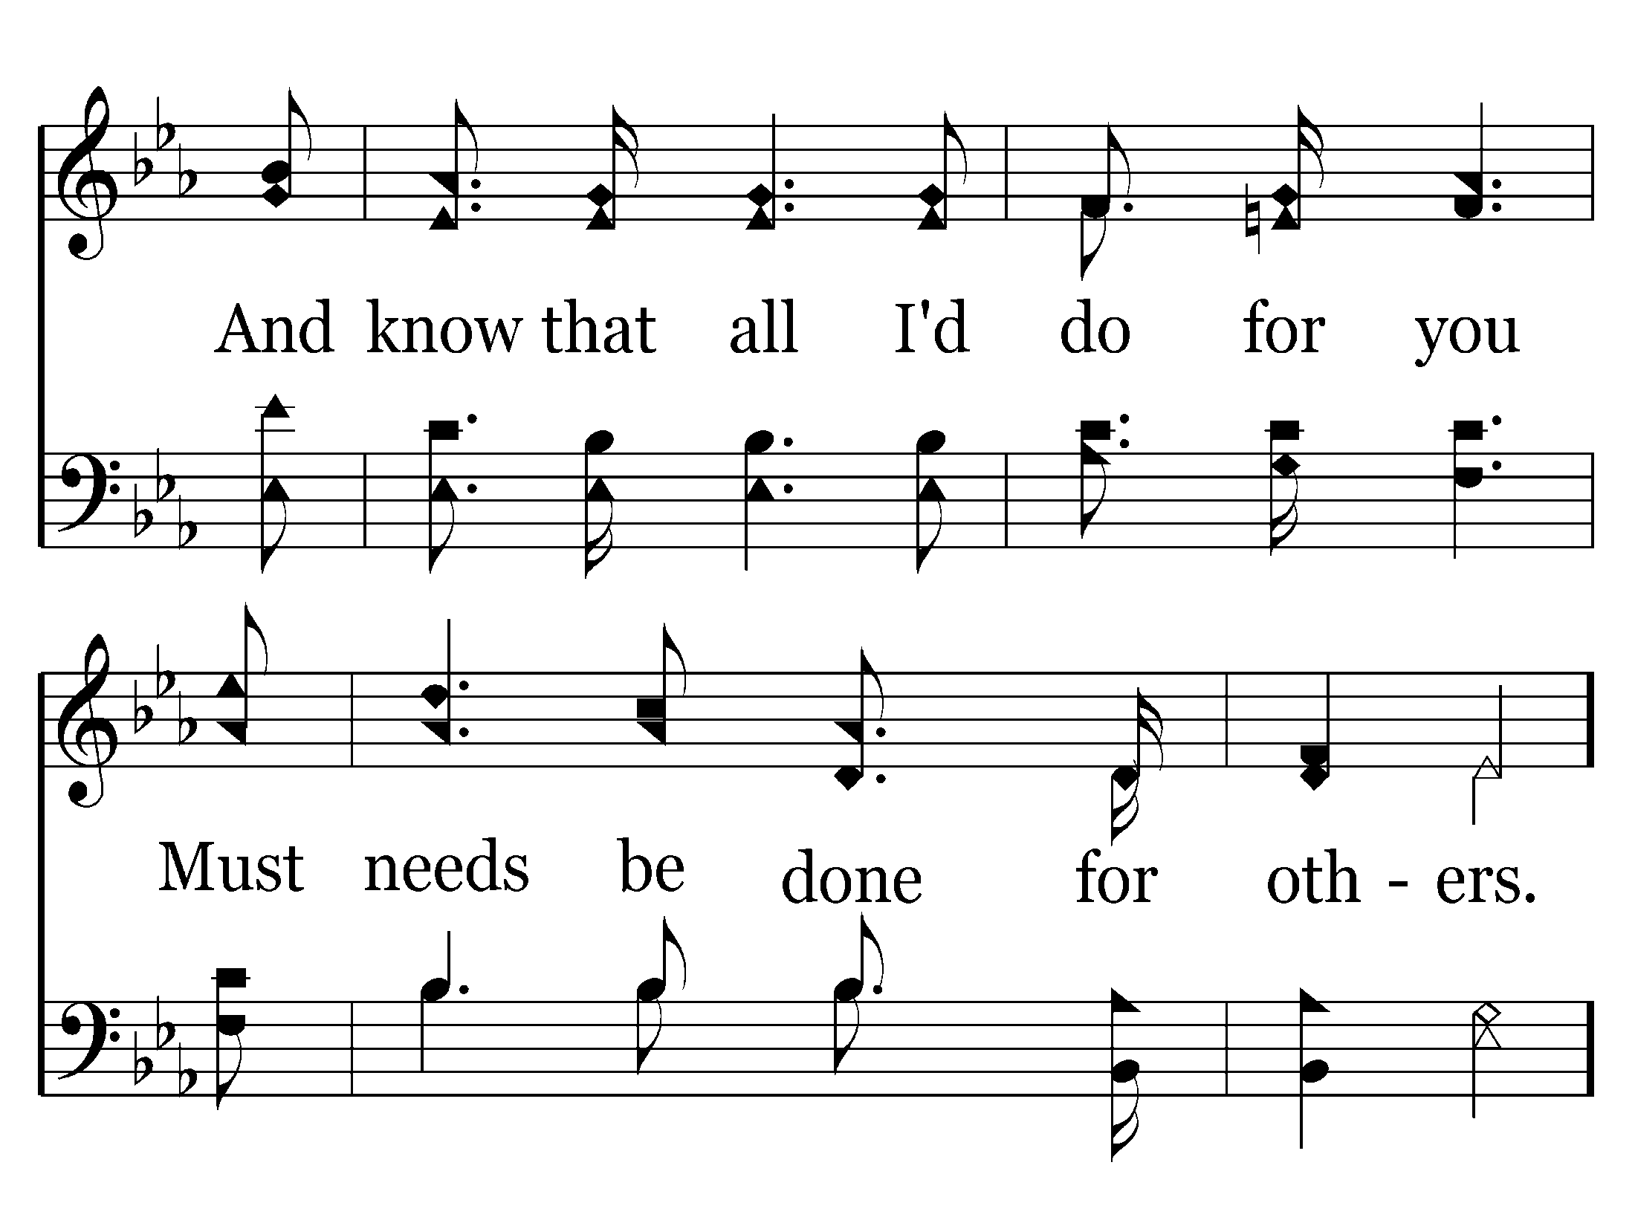

Slide 24
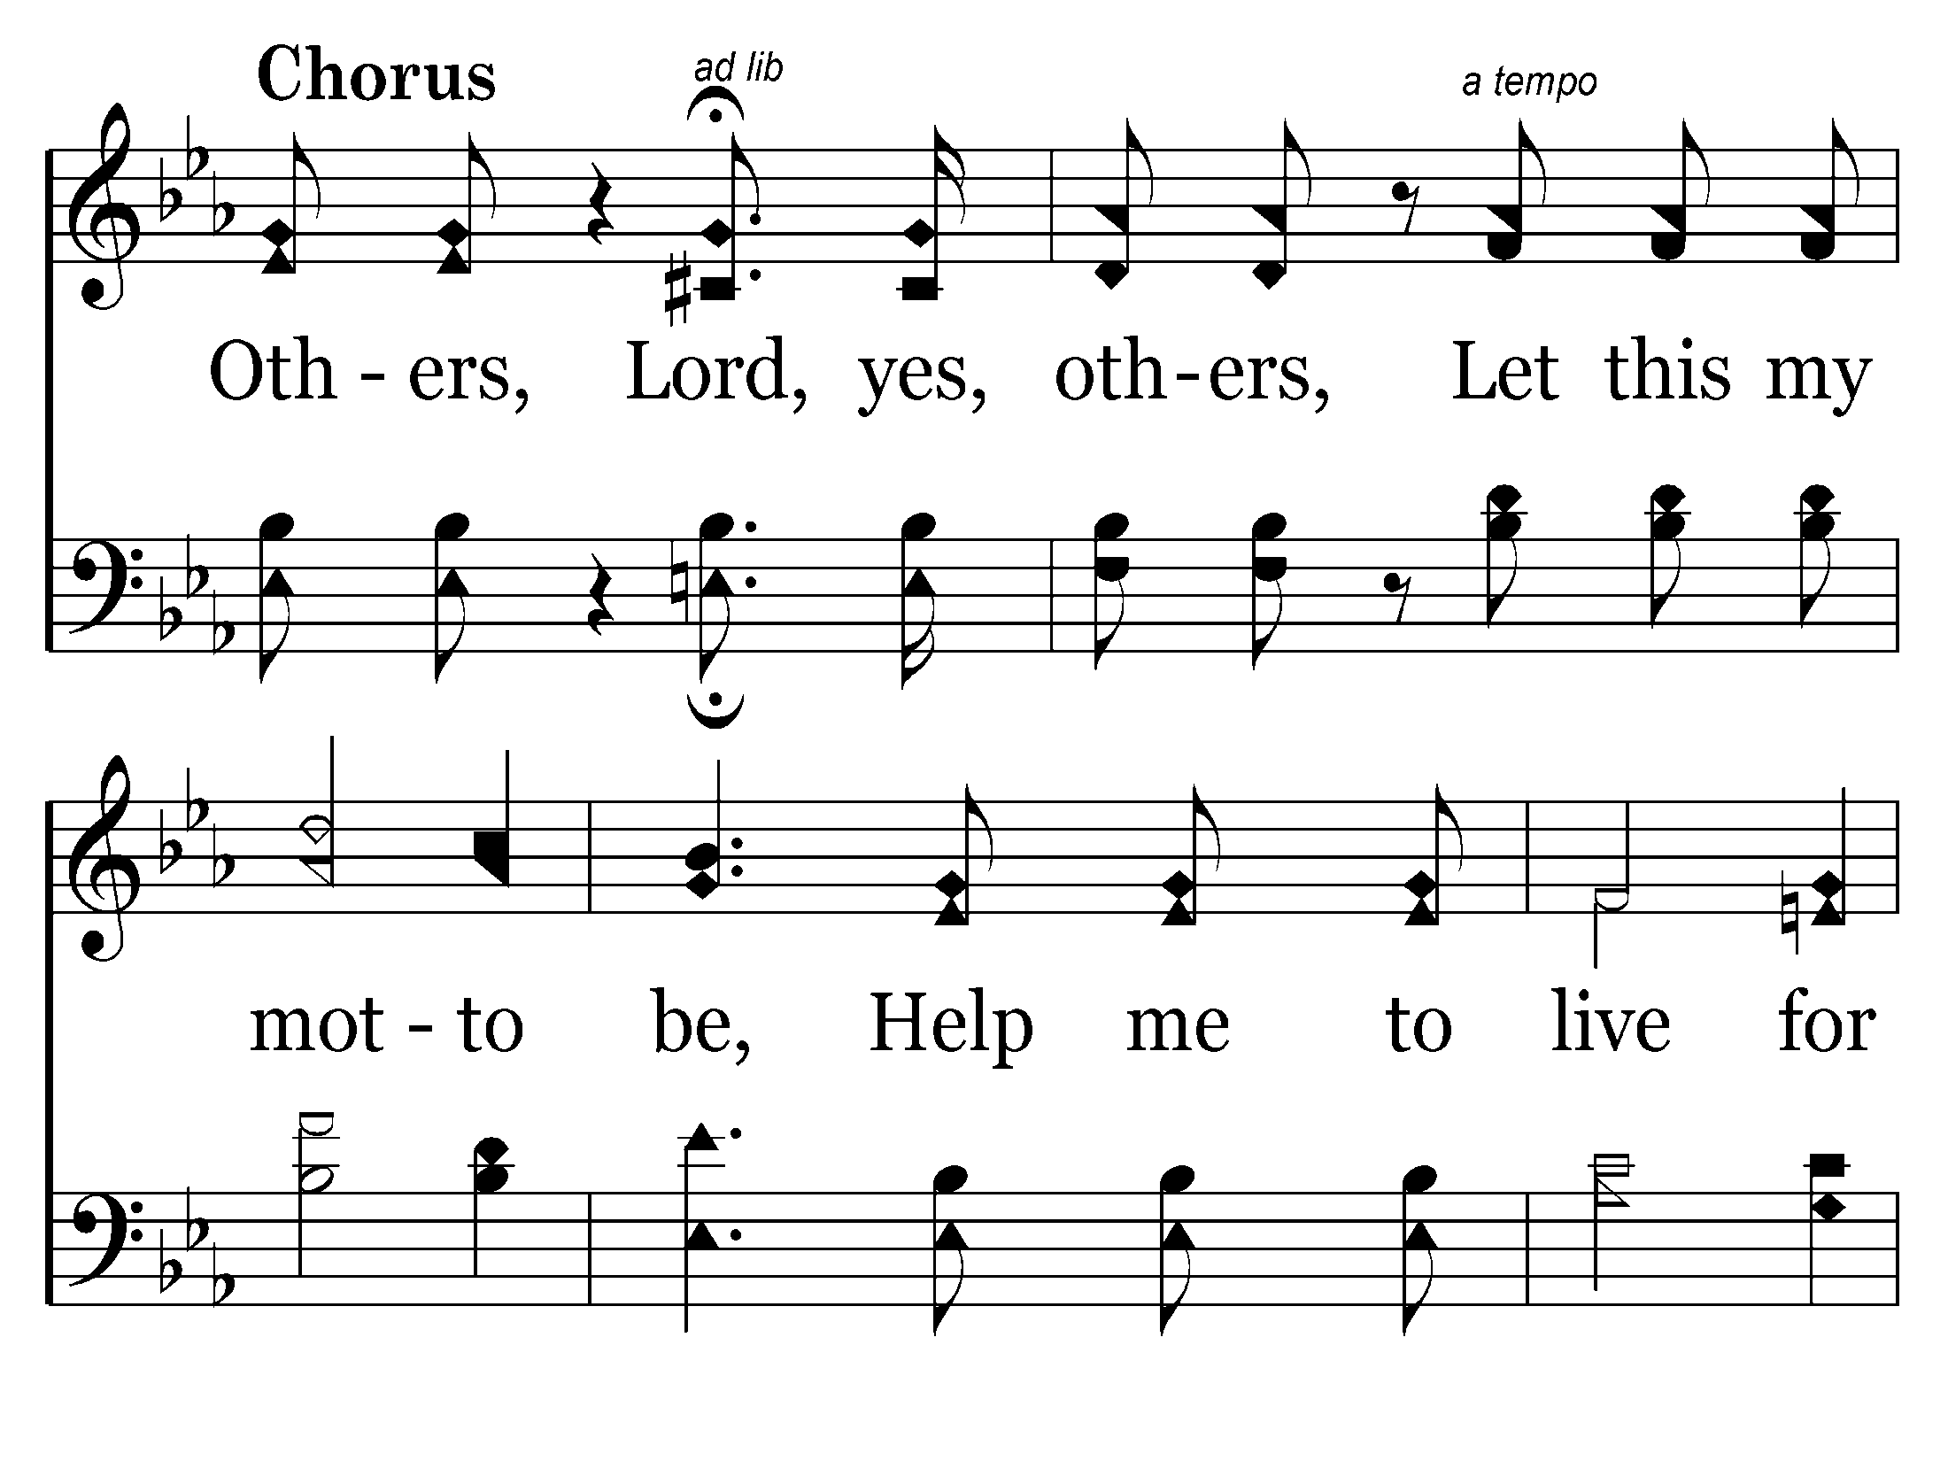

Slide 25
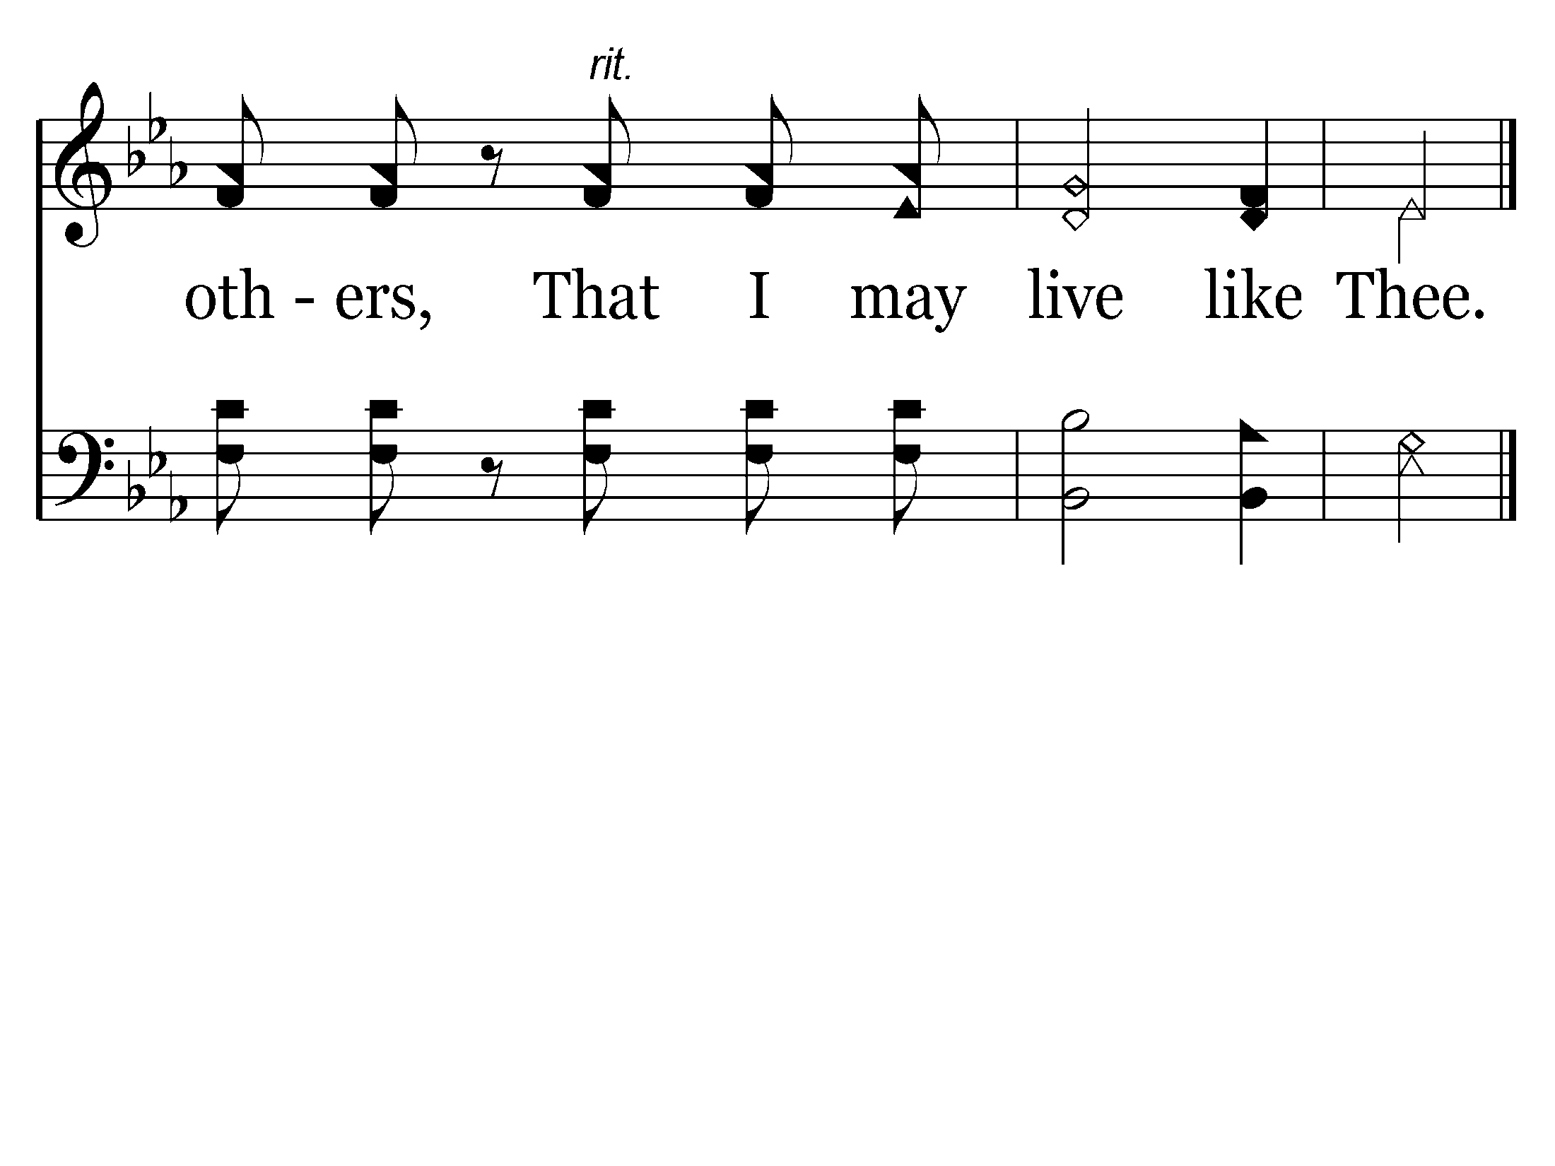
End of Song

Slide 26
THE HEART OF A SERVANT
THIS TYPE OF SERVICE
Doesn’t WORRY about MY RIGHTS!
Doesn’t expect to be served in return.
John 13:15
"For I have given you an example, that you should do as I have done to you.

Slide 27
THE HEART OF A SERVANT
THIS TYPE OF SERVICE
Doesn’t WORRY about MY RIGHTS!
Doesn’t expect to be served in return.
Doesn’t WAIT for others to begin.

Slide 28
THE HEART OF A SERVANT
THIS TYPE OF SERVICE
Doesn’t WORRY about MY RIGHTS!
Doesn’t expect to be served in return.
Doesn’t WAIT for others to begin.
SERVES ALONE if necessary.

Slide 29
THE HEART OF A SERVANT
THIS TYPE OF SERVICE
Doesn’t WORRY about MY RIGHTS!
Doesn’t expect to be served in return.
Doesn’t WAIT for others to begin.
SERVES ALONE if necessary.
Doesn’t expect a favorable response.
John 13:7 - "What I am doing you do not understand now, but you will know after this."

Slide 30
THE HEART OF A SERVANT
THIS TYPE OF SERVICE
Doesn’t WORRY about MY RIGHTS!
Doesn’t expect to be served in return.
Doesn’t WAIT for others to begin.
SERVES ALONE if necessary.
Doesn’t expect a favorable response.
Not just reserved for MY friends.
Mt. 5:43-48; Rom. 12:17-21

Slide 32
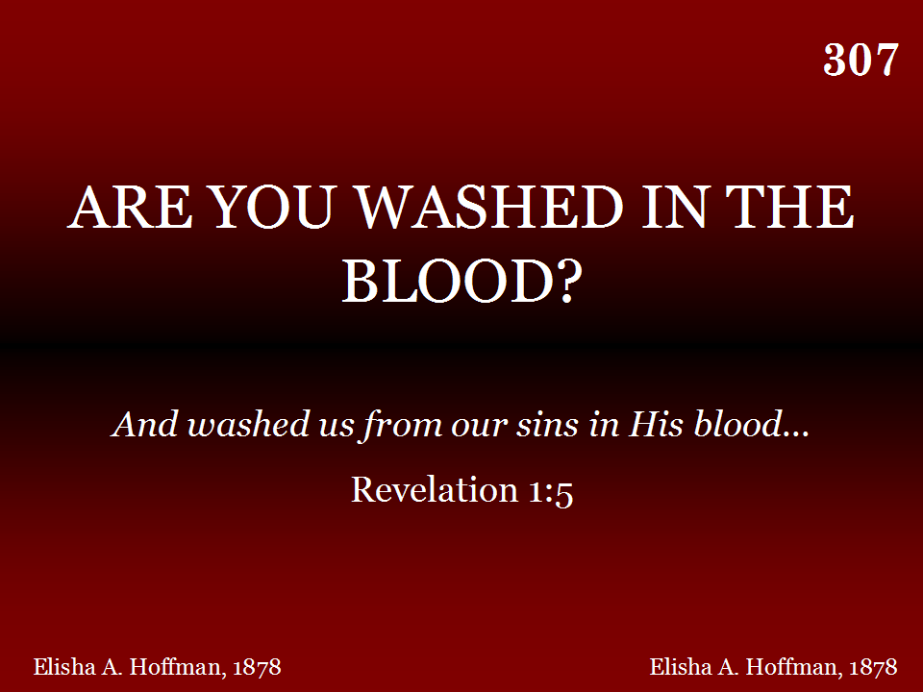

Slide 33
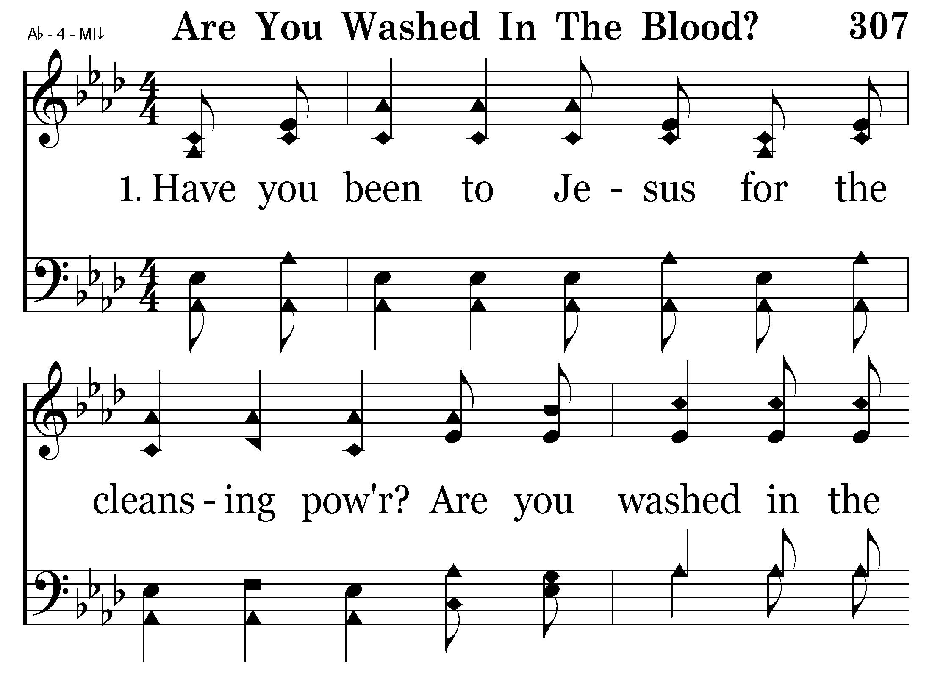

Slide 34
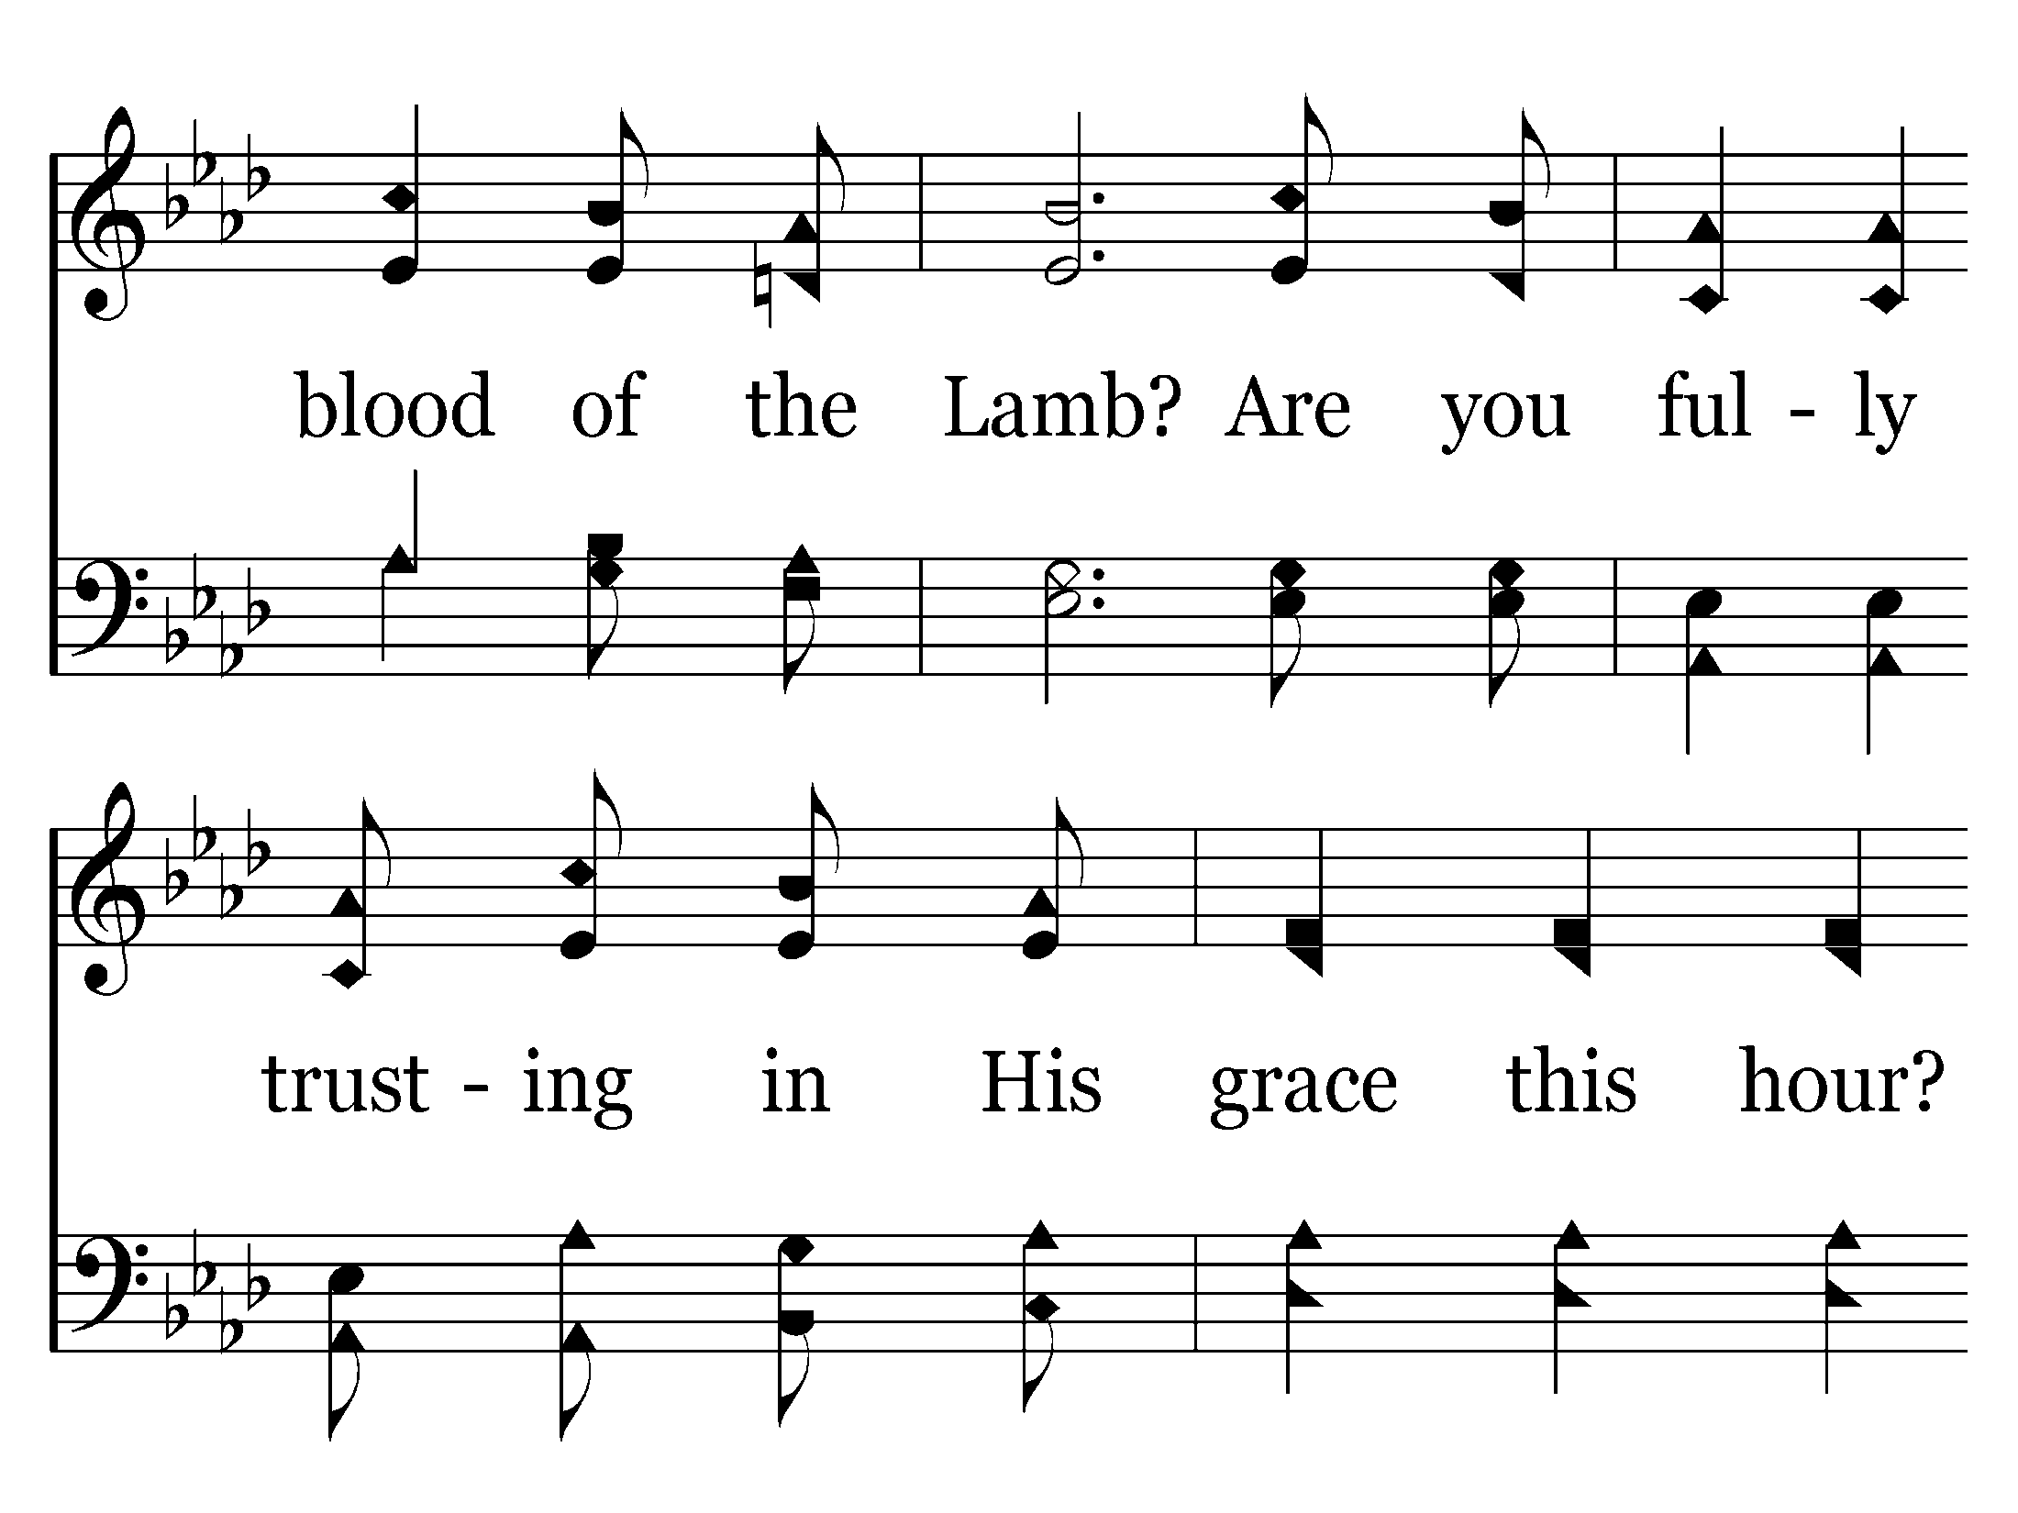

Slide 35
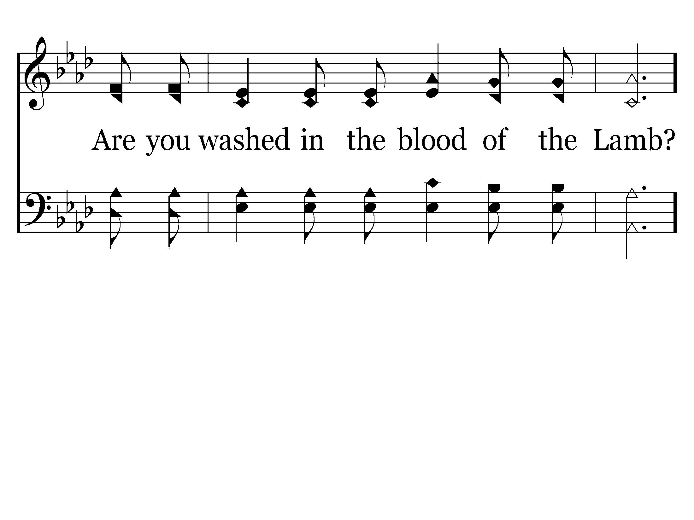
Go back to verse 2

Slide 36
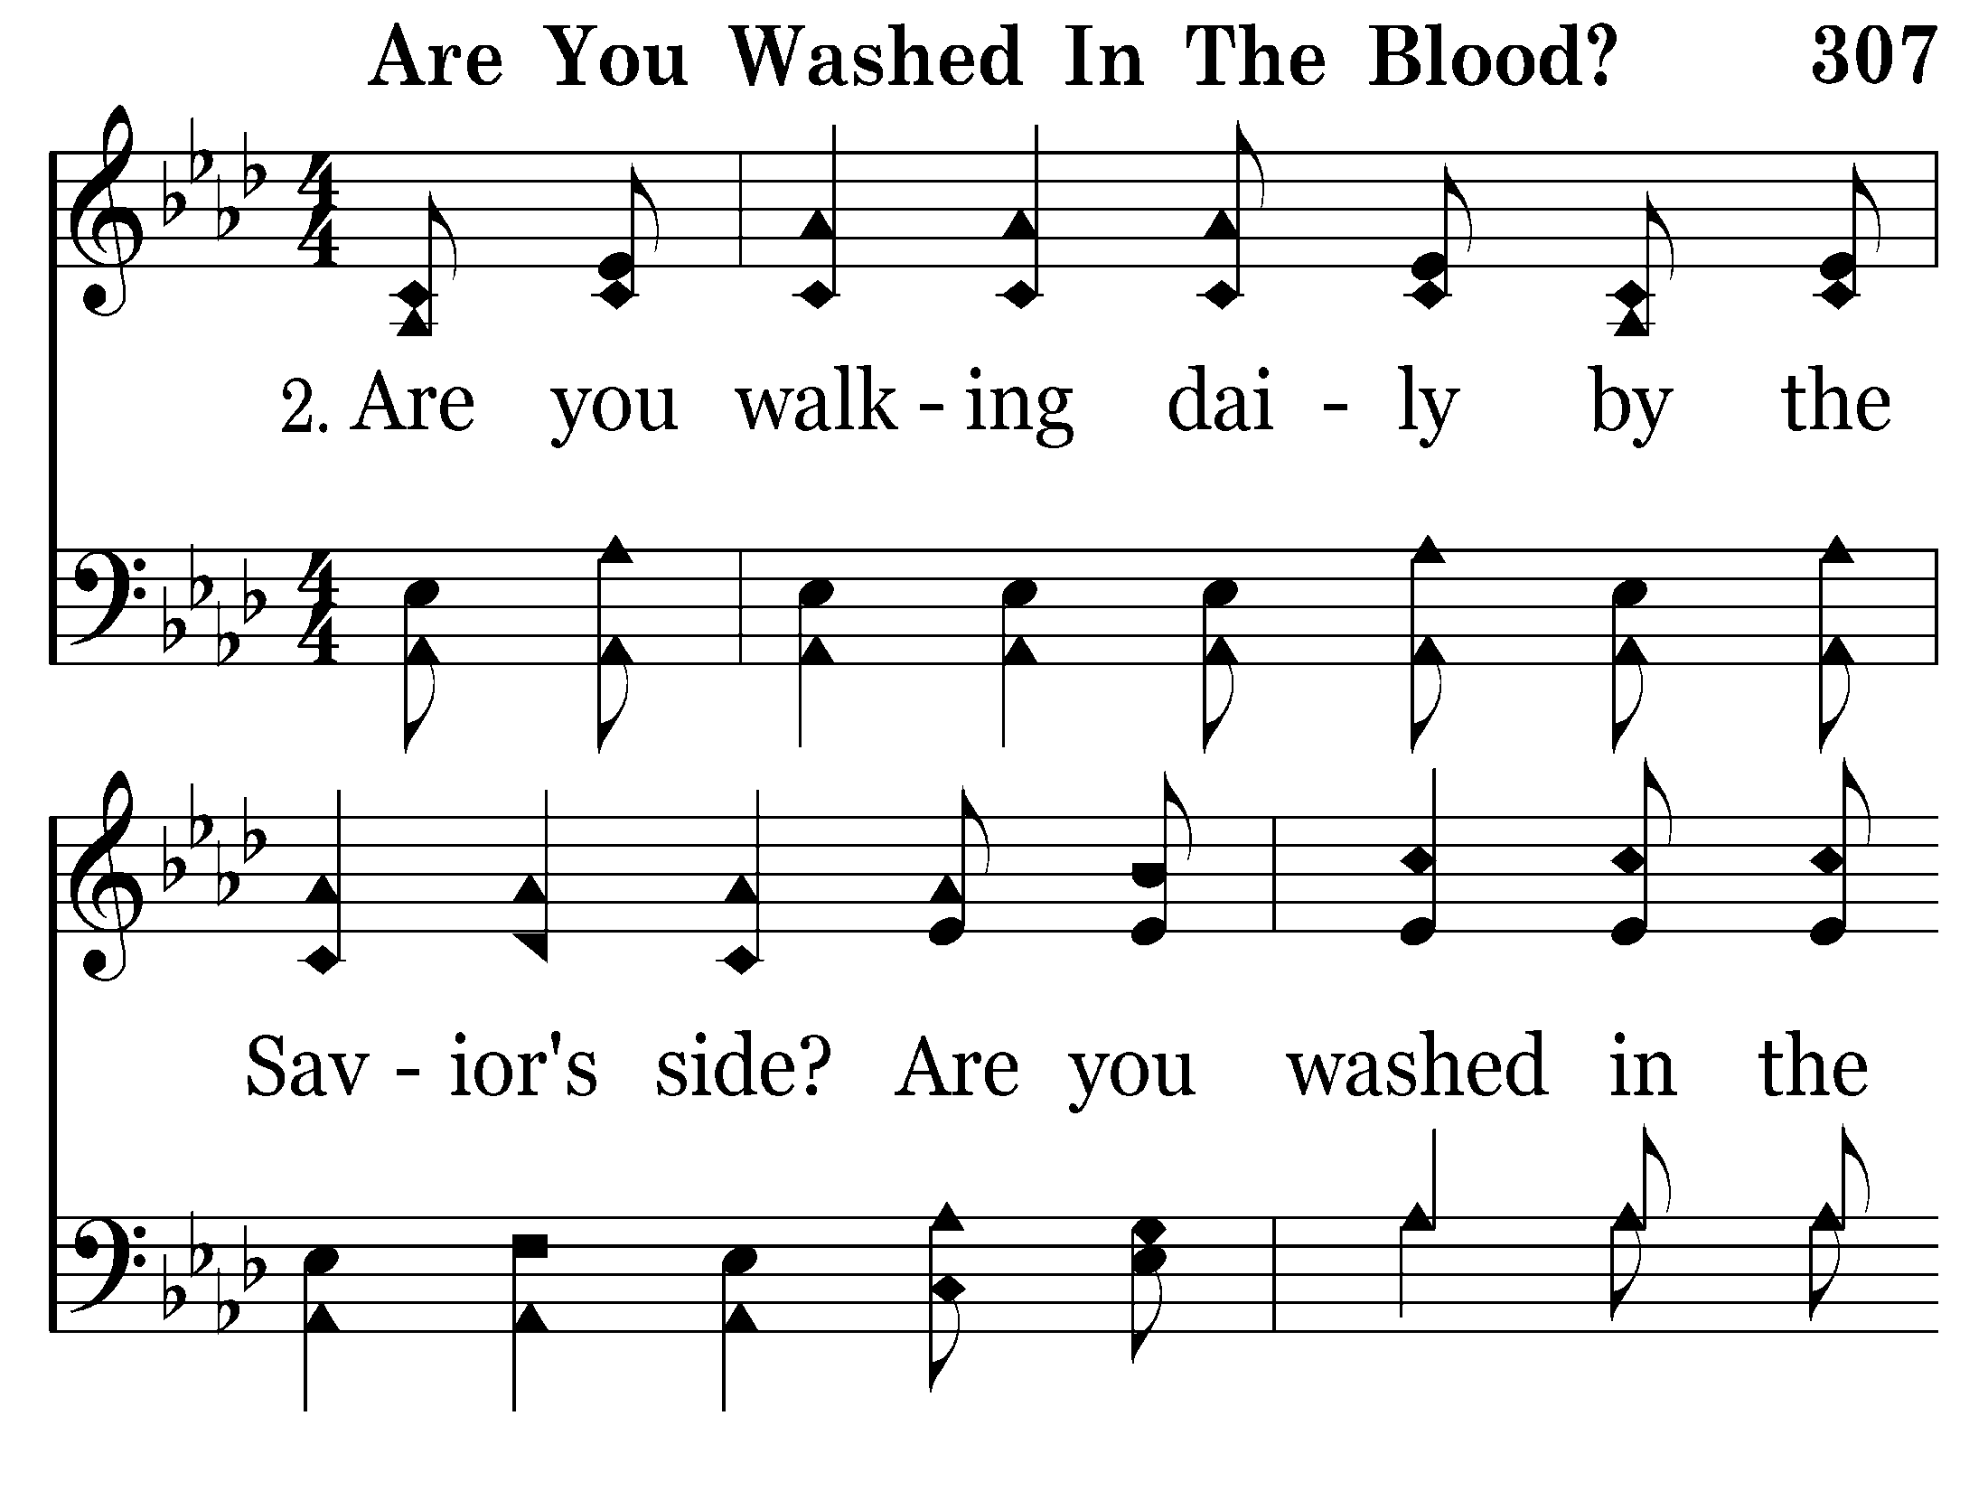

Slide 37
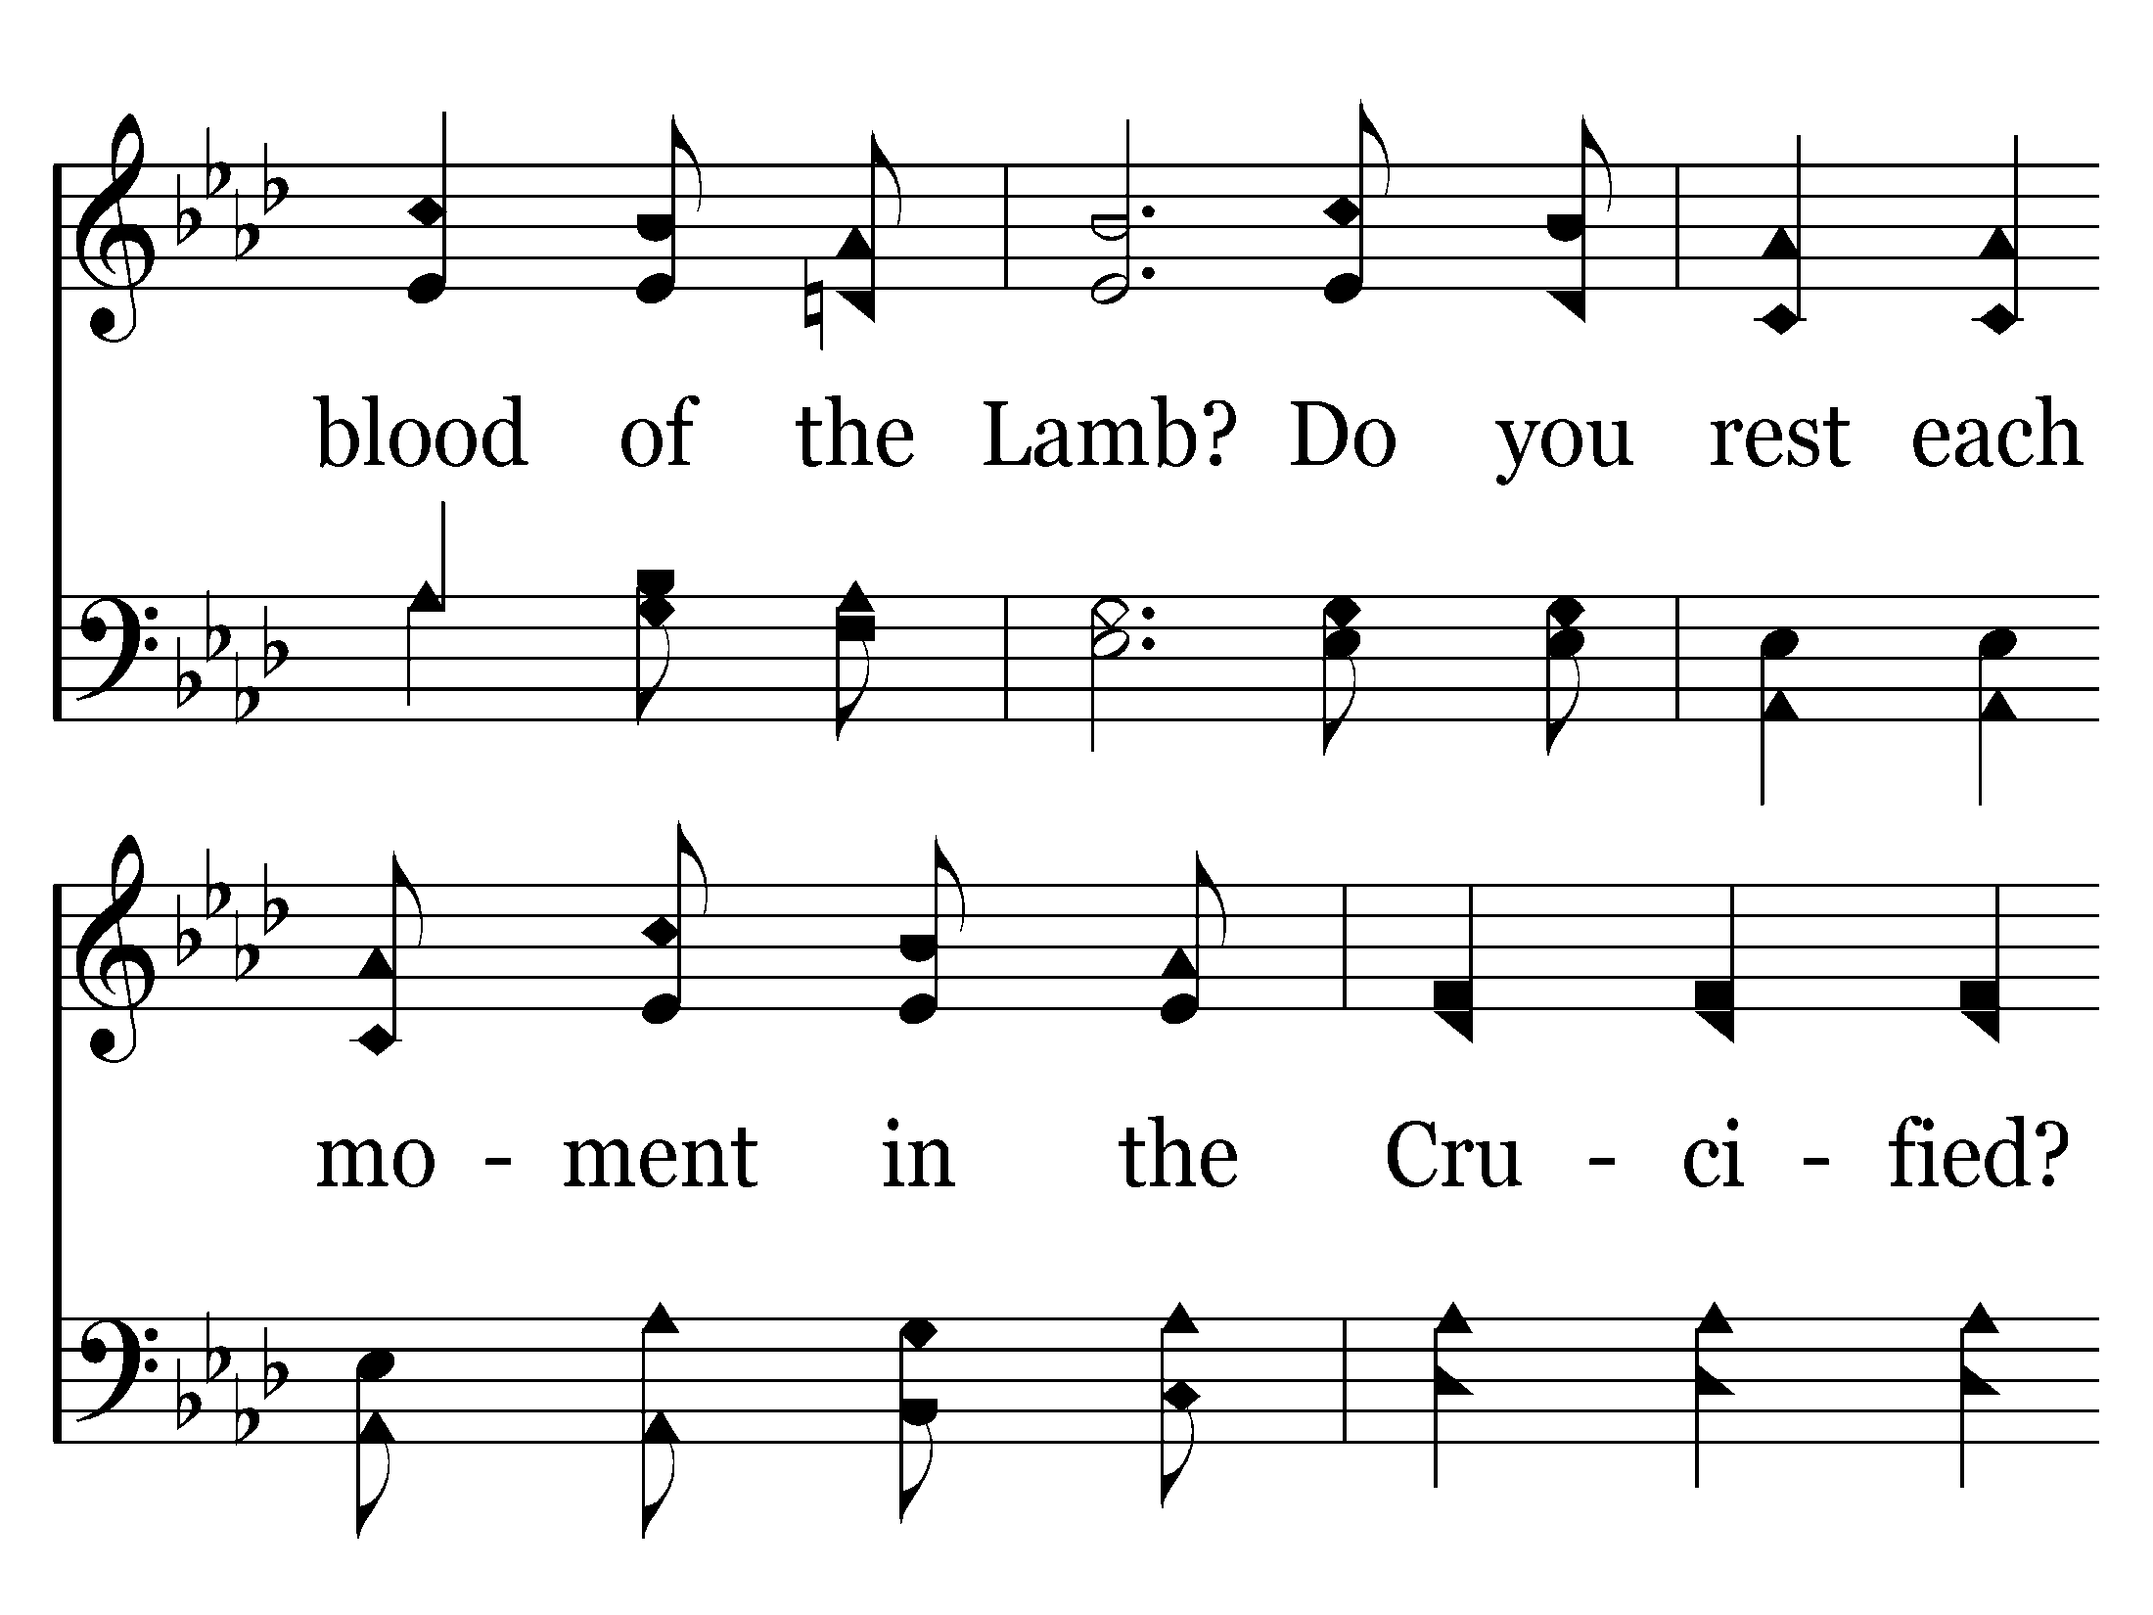

Slide 38
Go back to verse 3

Slide 39
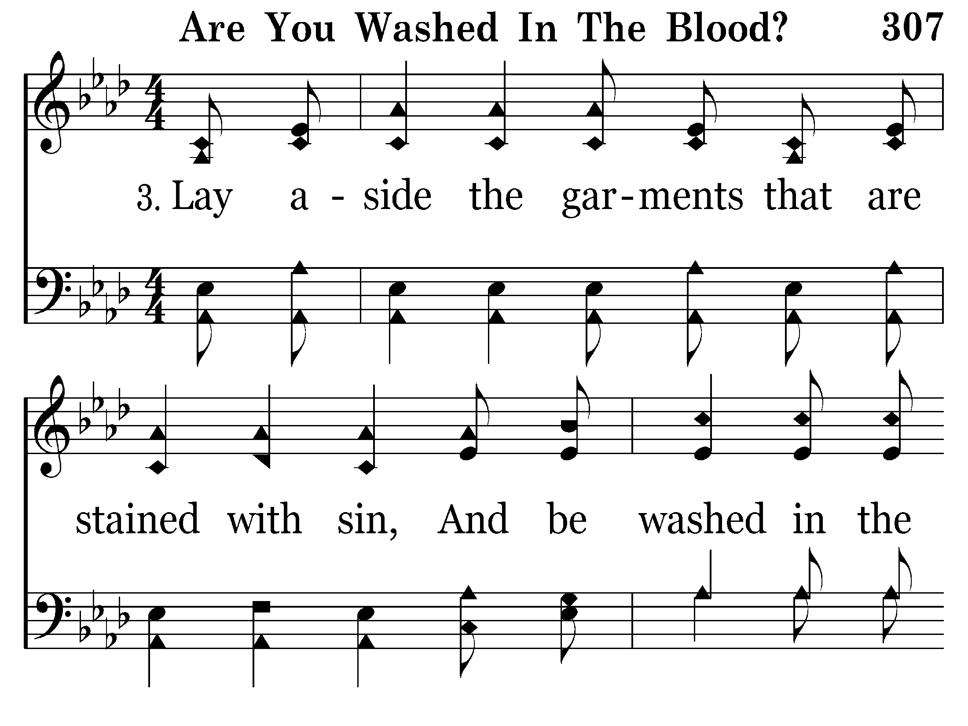

Slide 40
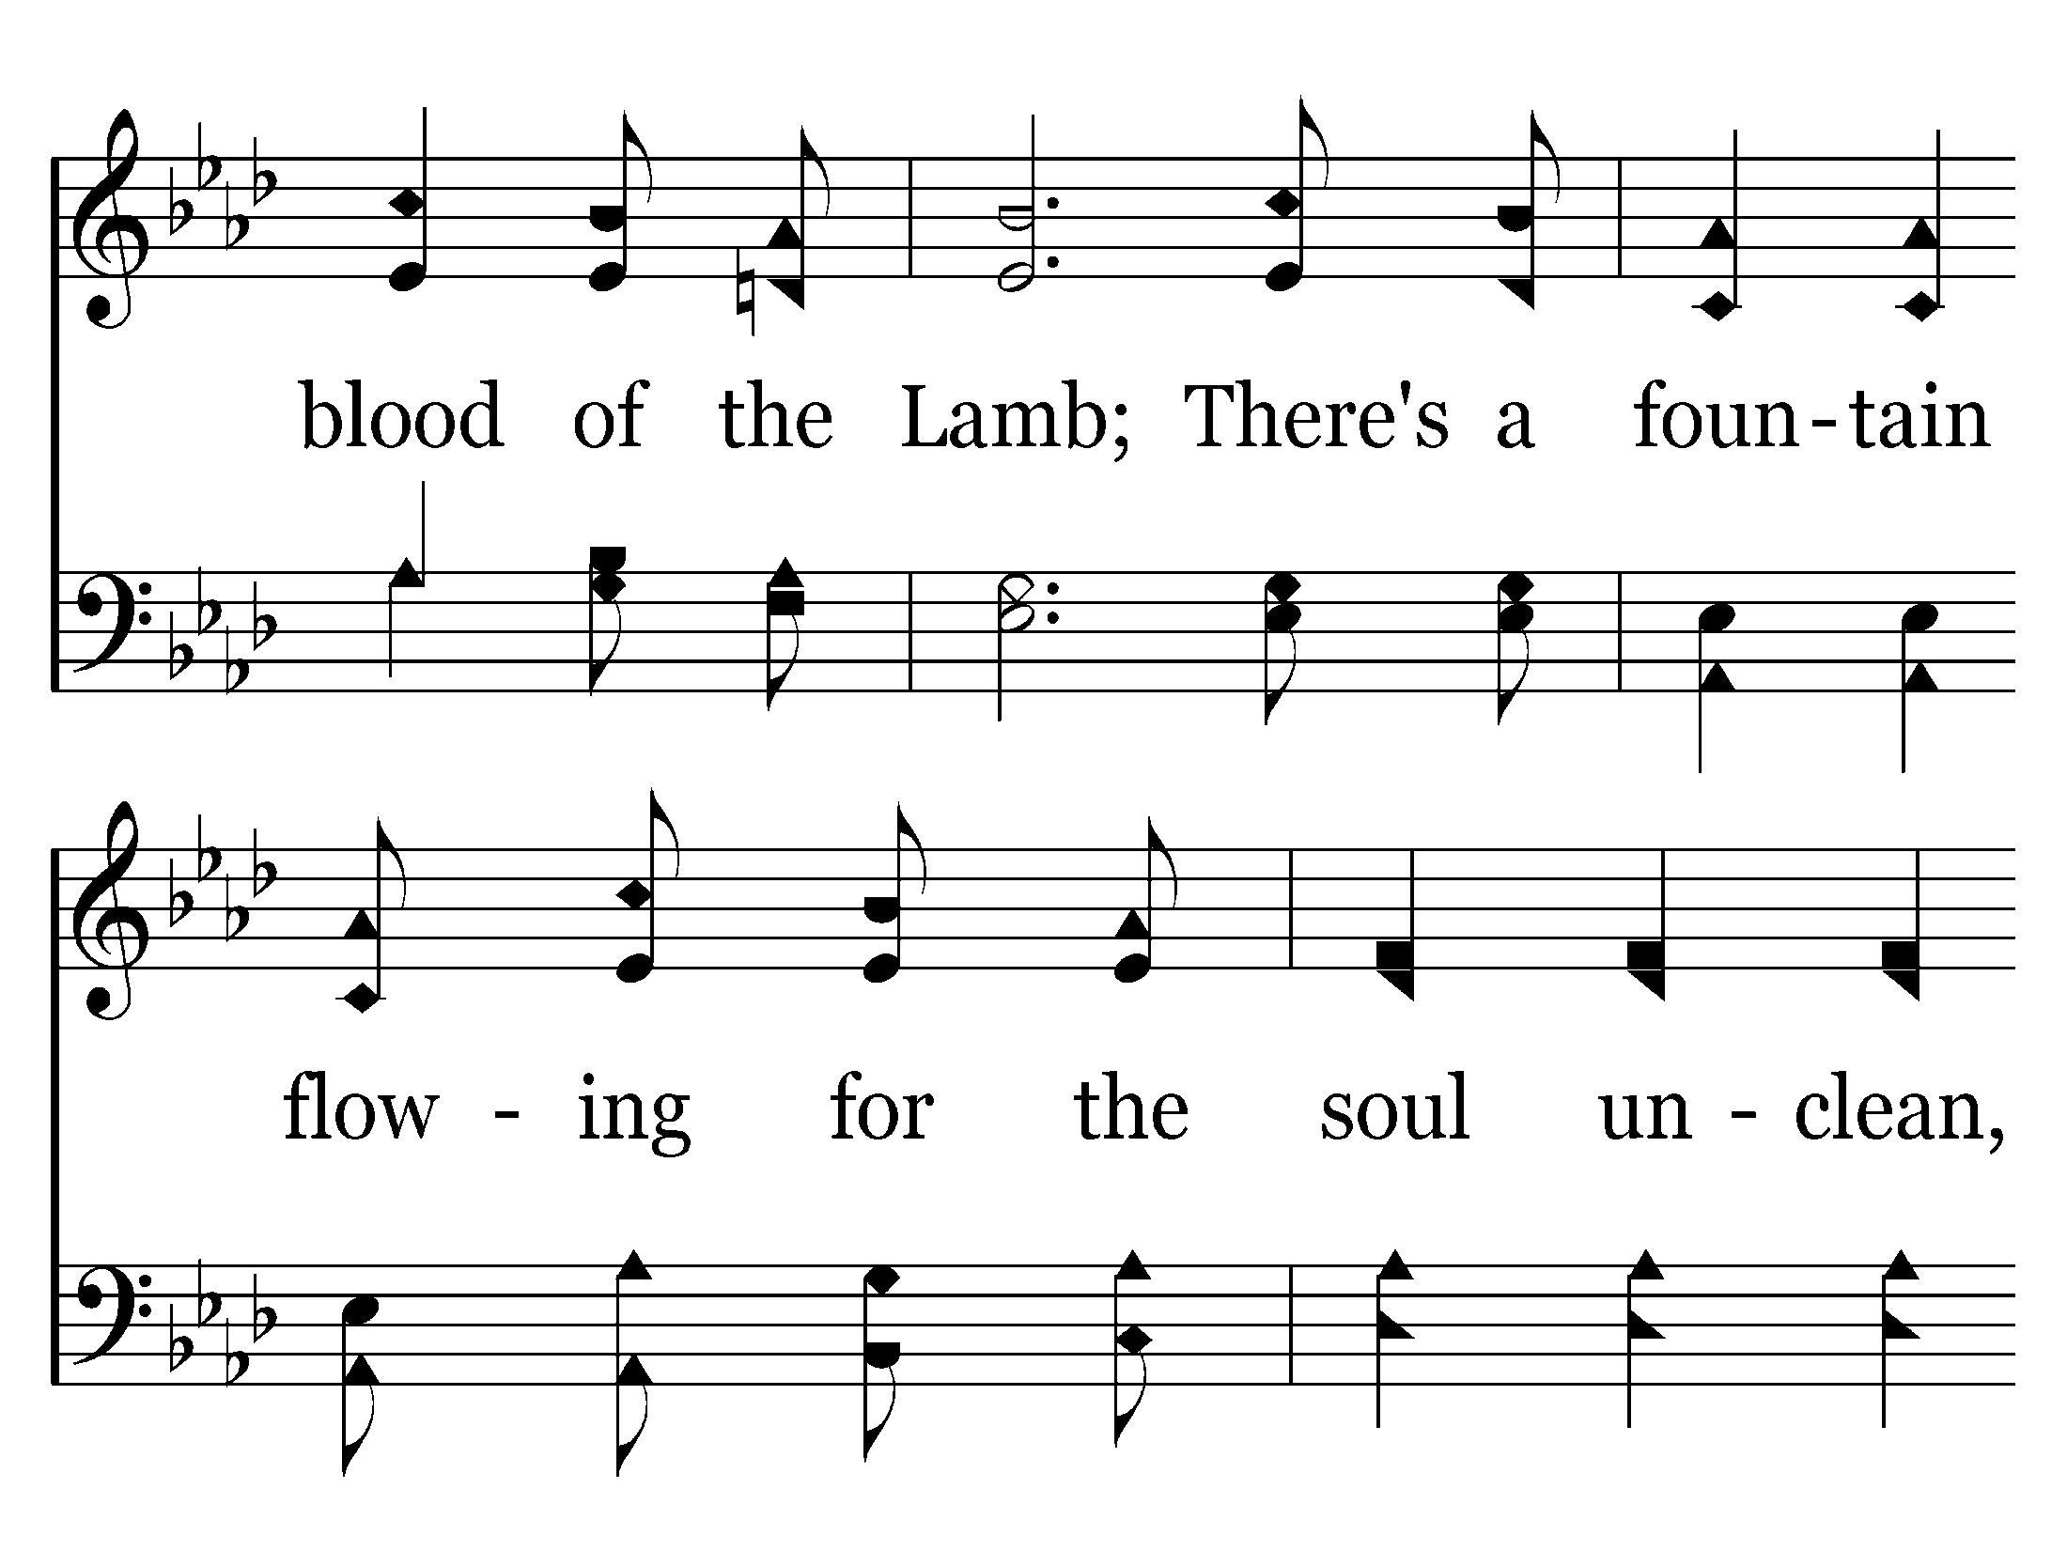

Slide 41
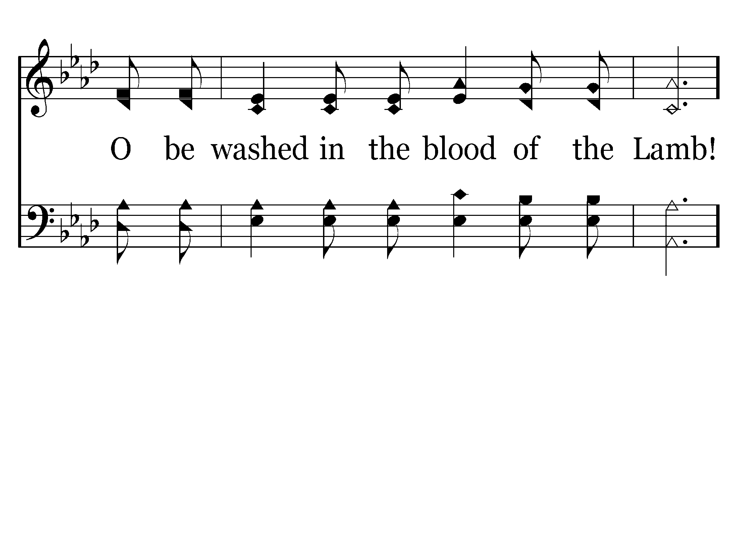

Slide 42
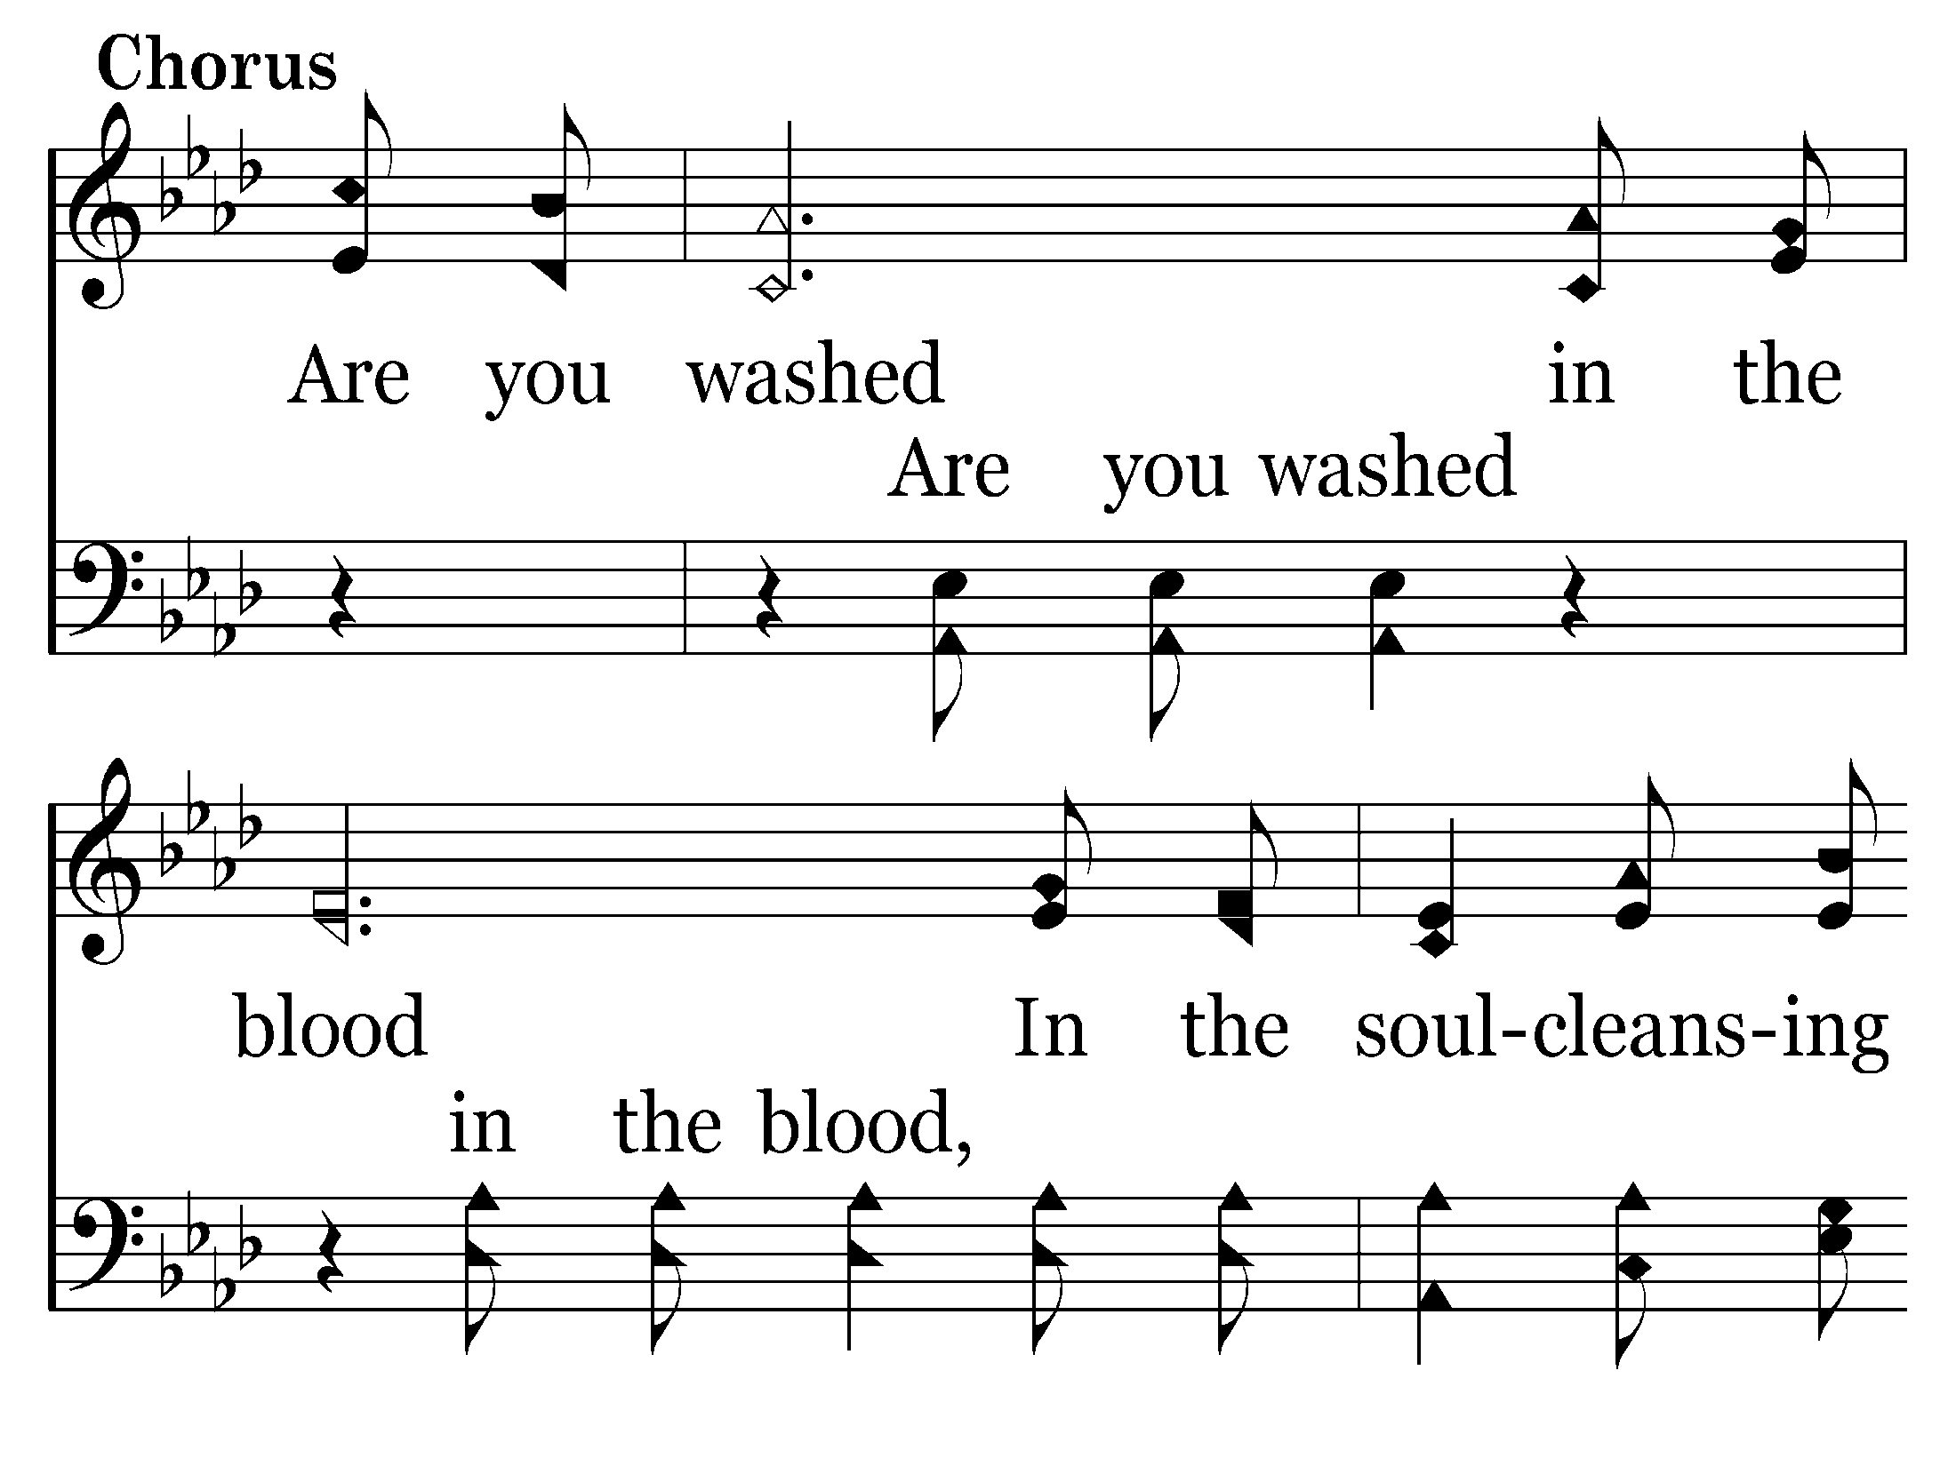

Slide 43
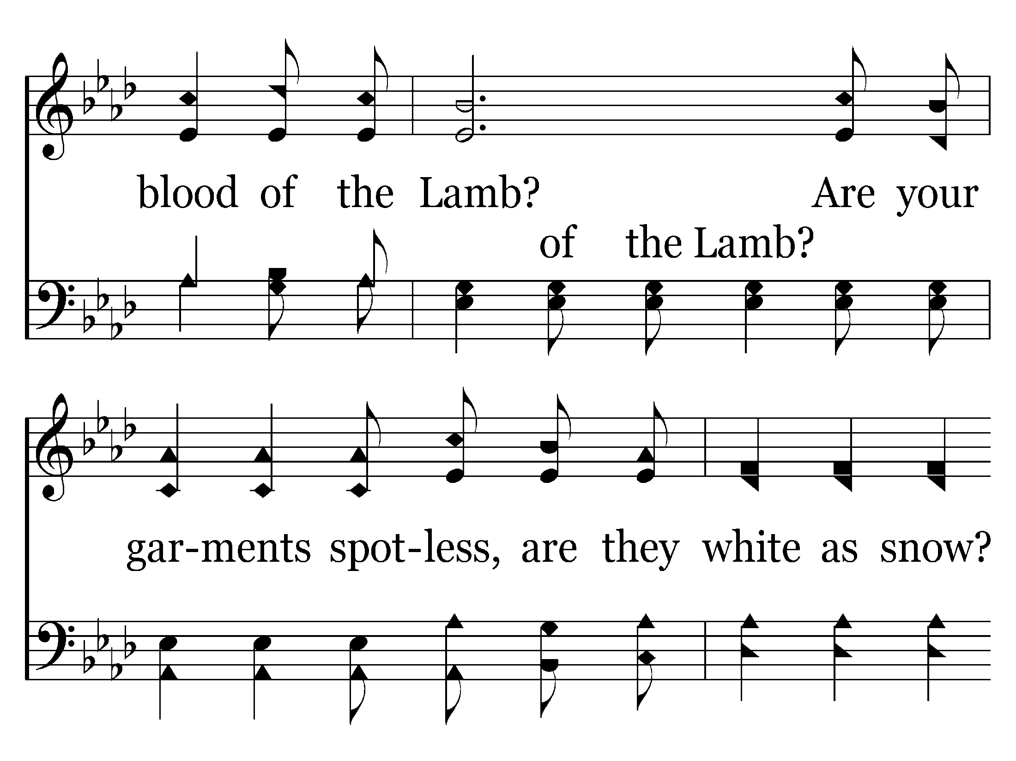

Slide 44
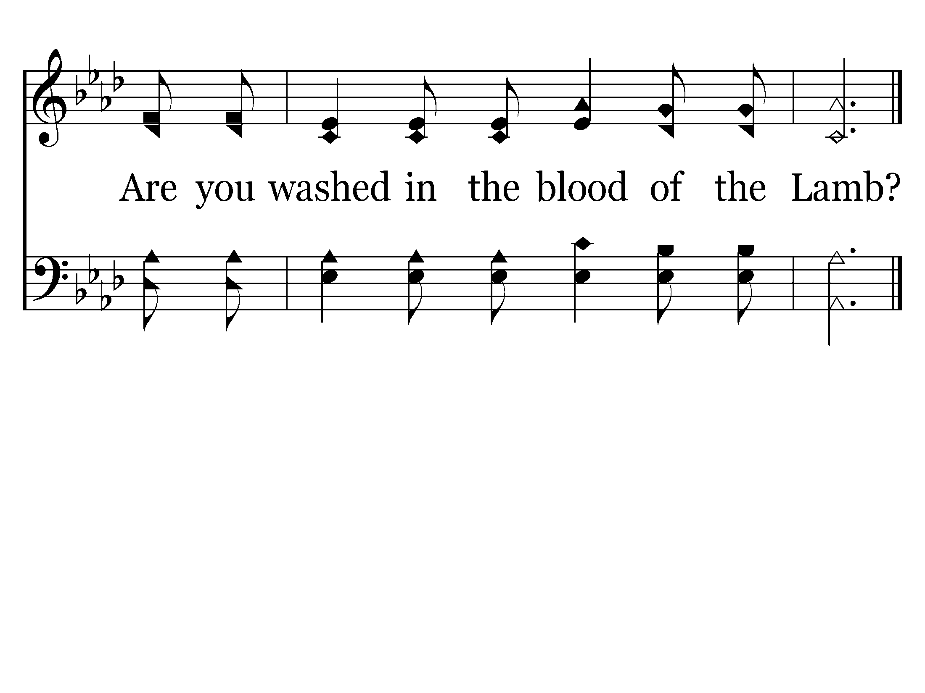
End of Song

Slide 45
THE HEART OF A SERVANT
THIS TYPE OF SERVICE
Doesn’t WORRY about MY RIGHTS!
Doesn’t expect to be served in return.
Doesn’t WAIT for others to begin.
SERVES ALONE if necessary.
Doesn’t expect a favorable response.
Not just reserved for MY friends.
LOOKS & is TREATED like a servant.

Slide 46
John 13:17
"If you know these things, blessed are you if you do them.

Slide 48
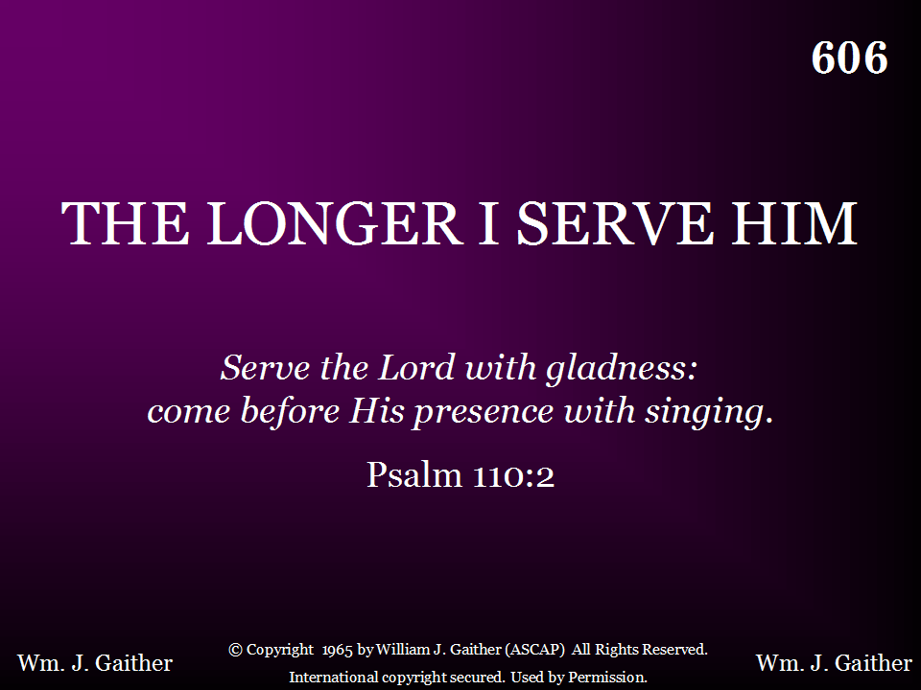

Slide 49
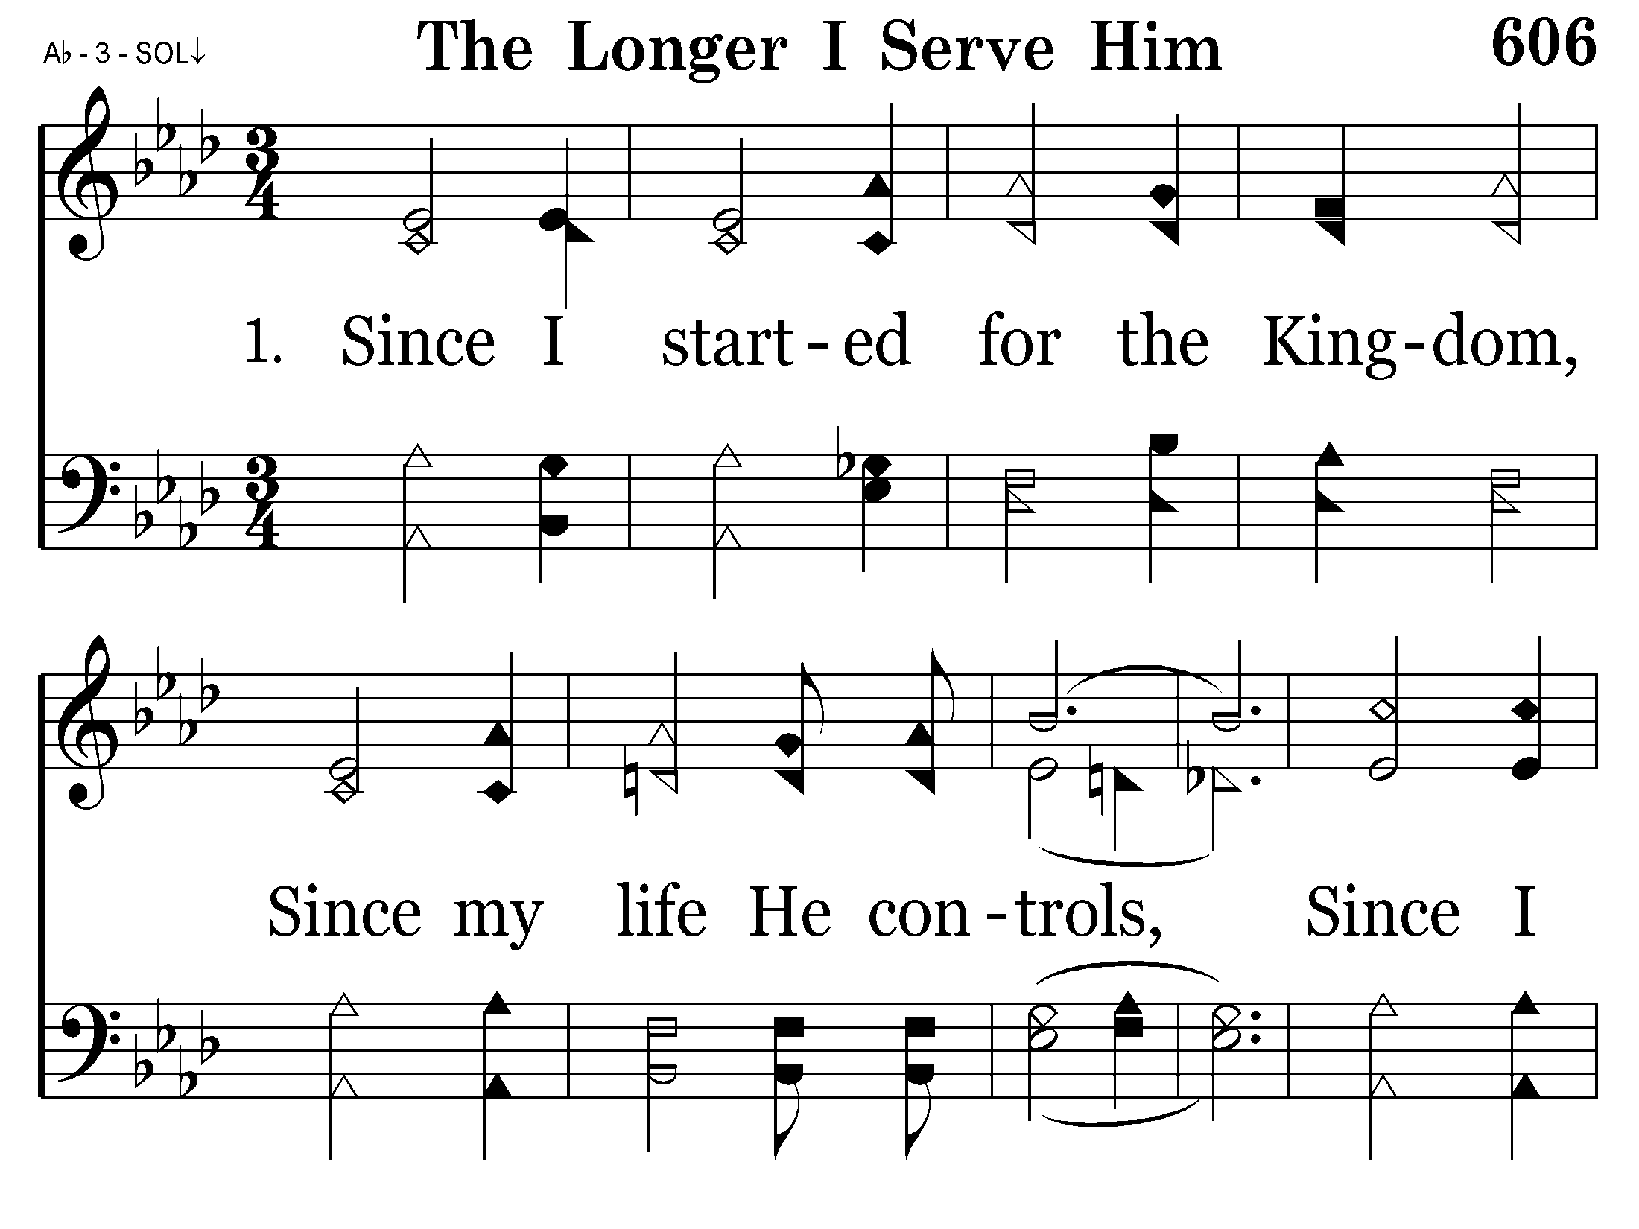

Slide 50
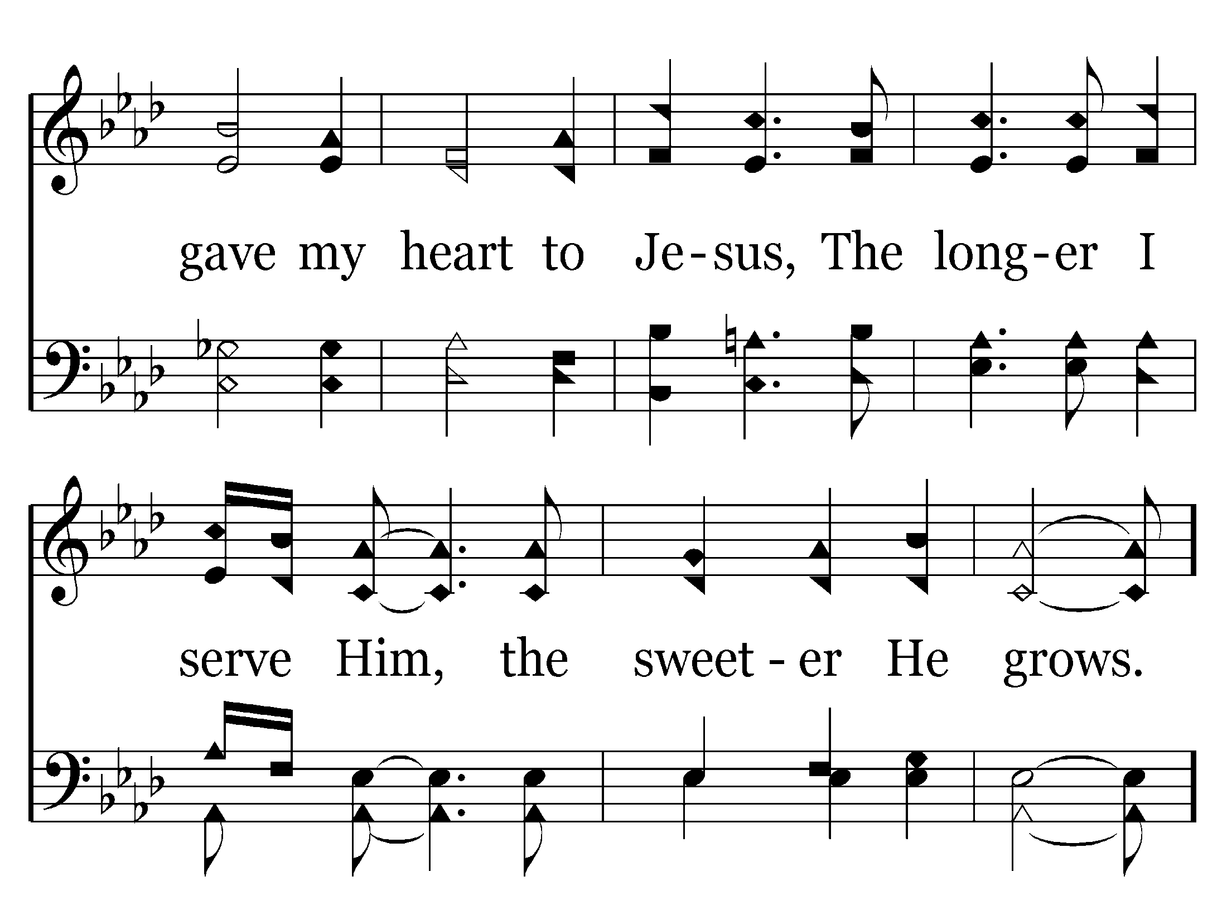

Slide 51
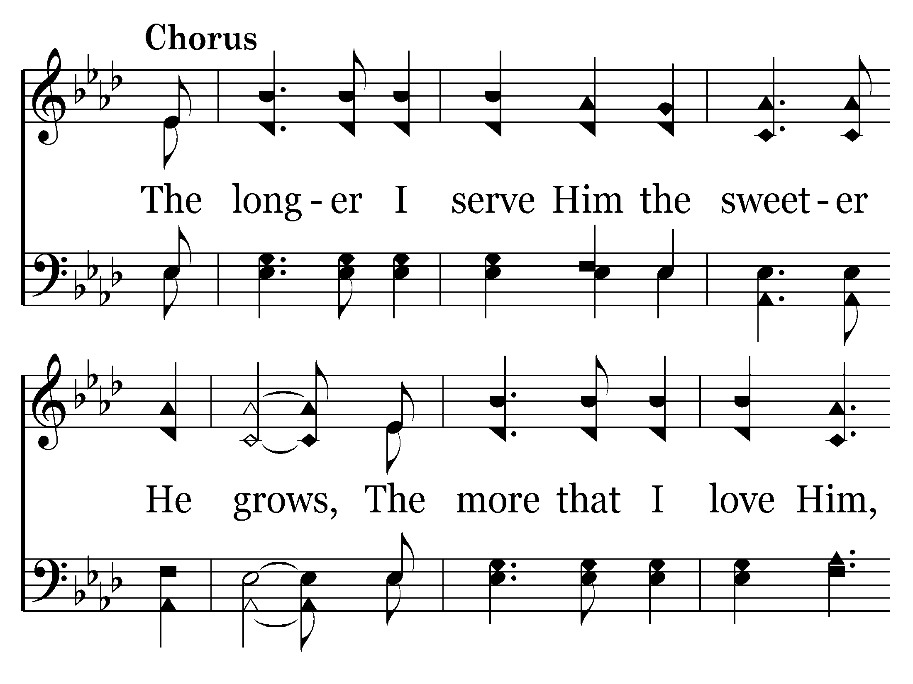

Slide 52
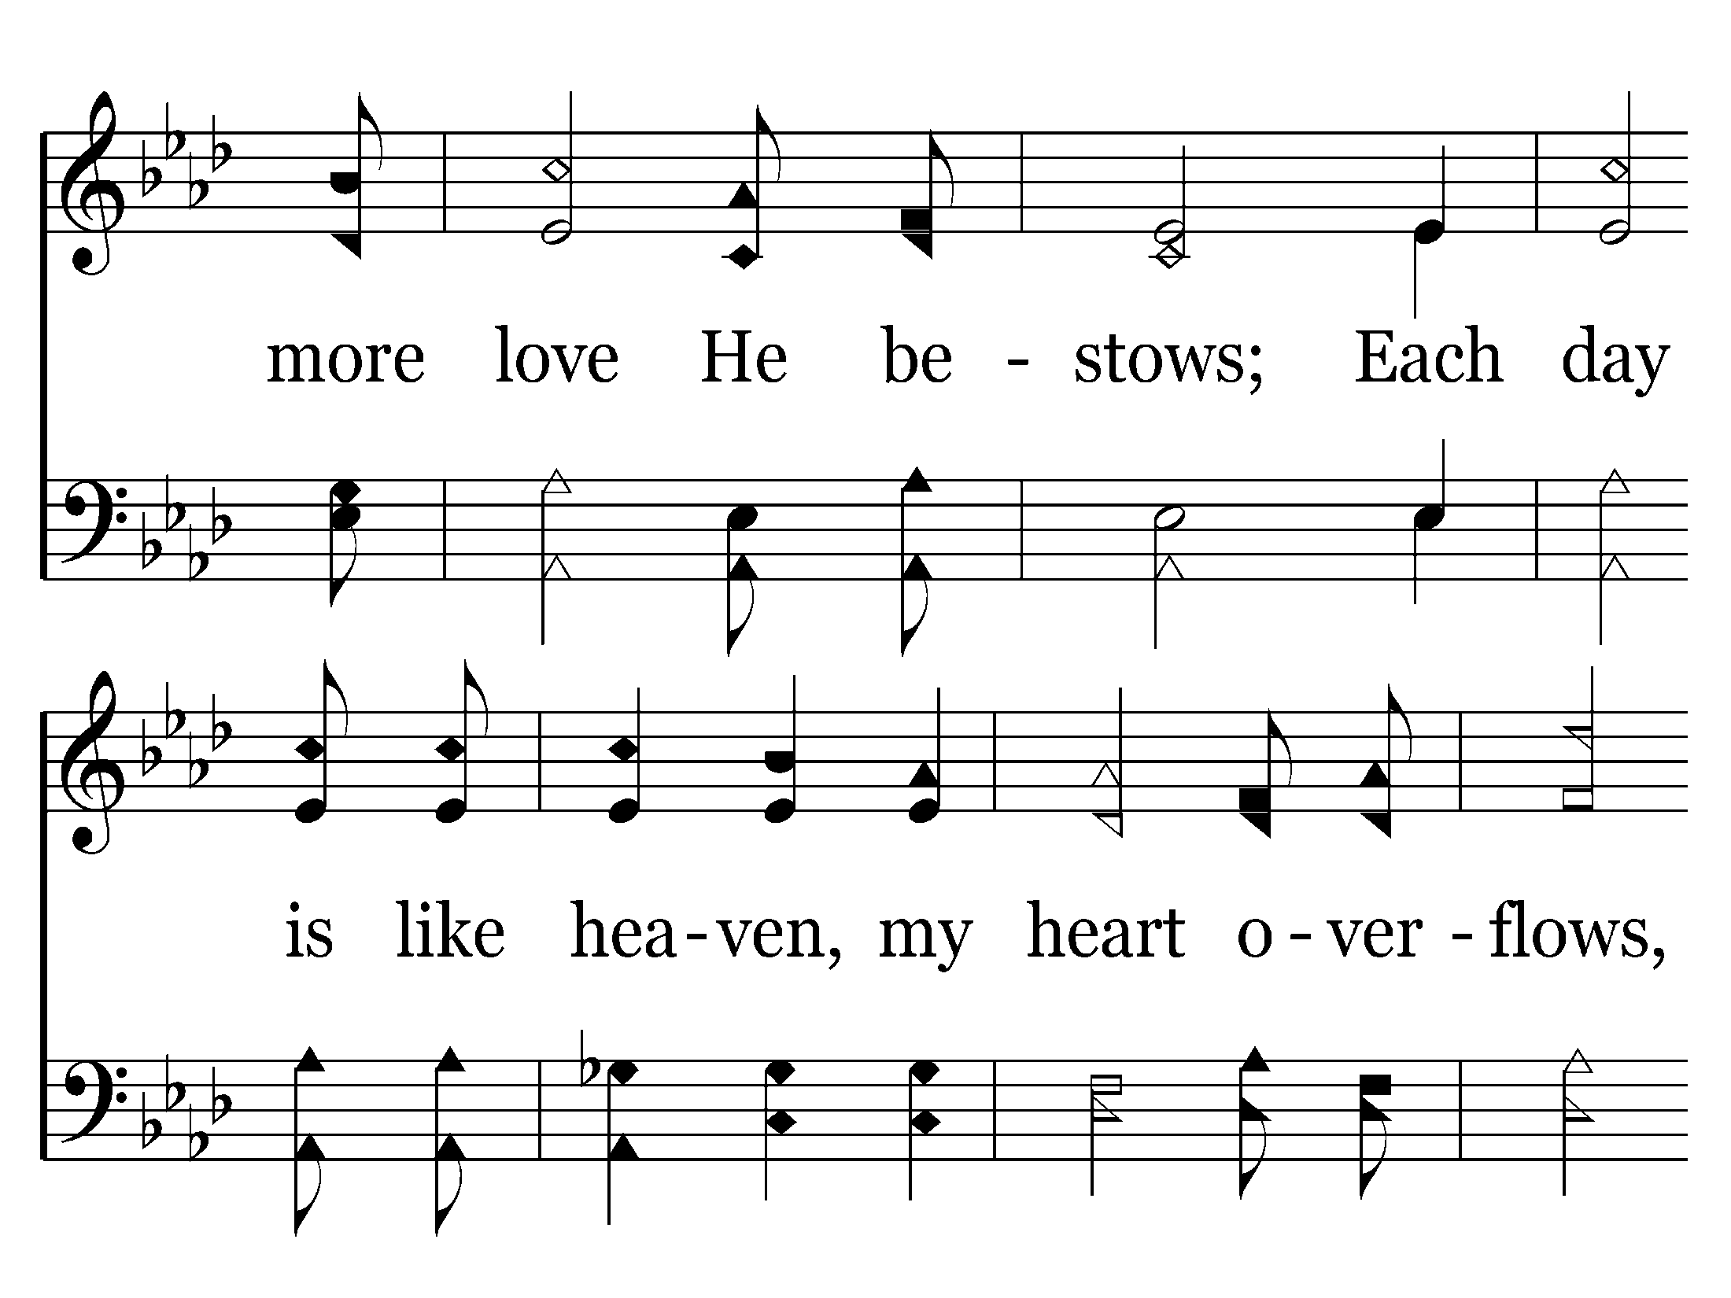

Slide 53
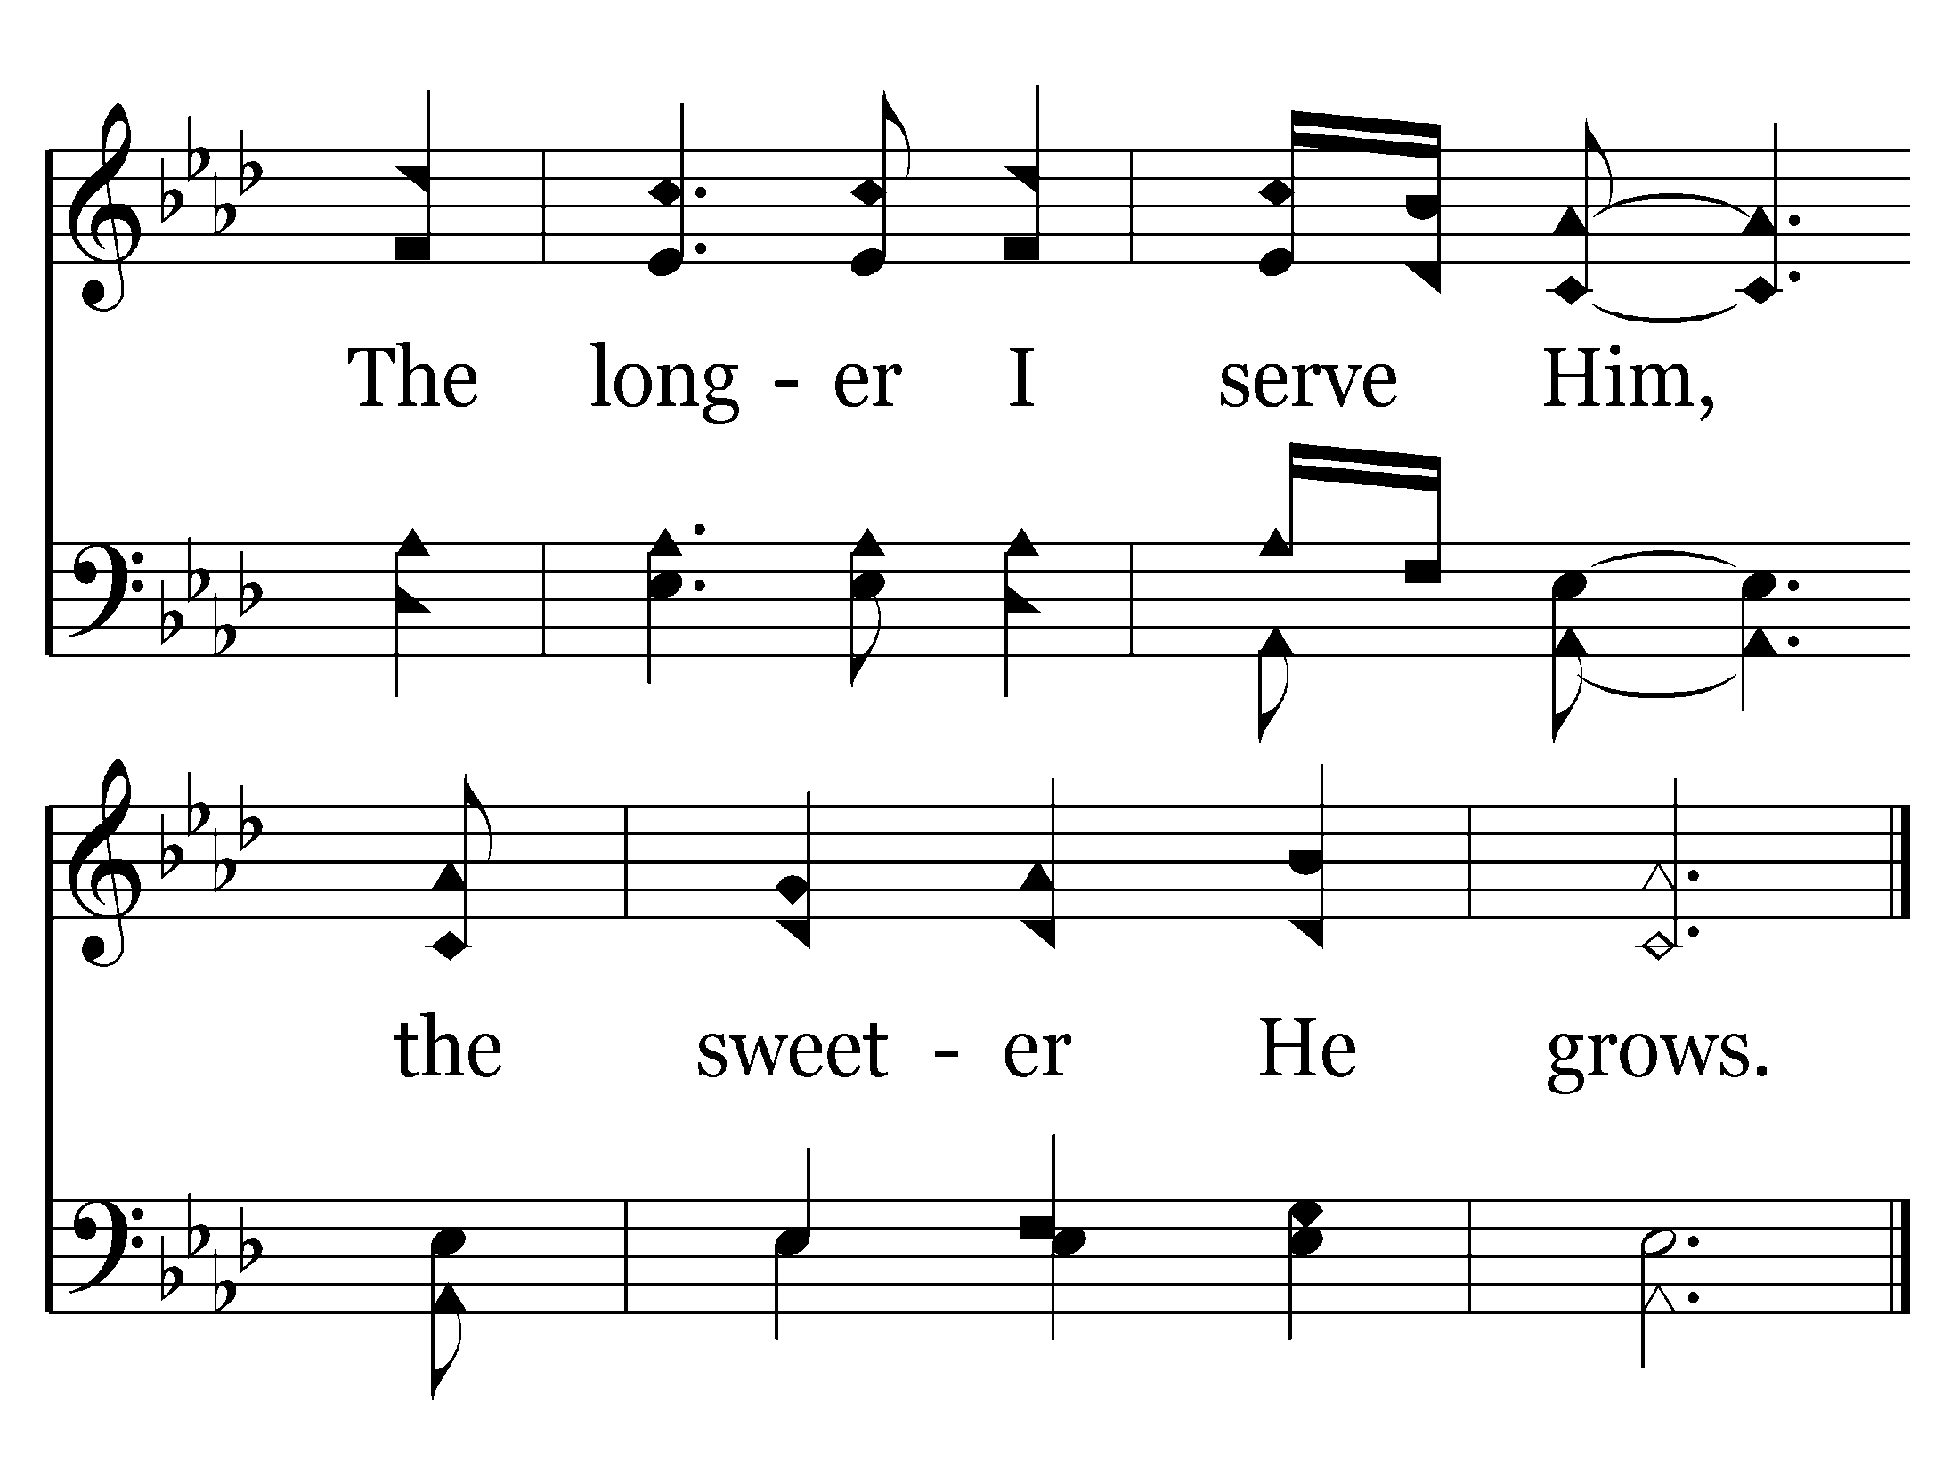
End of Verse 1

Slide 54
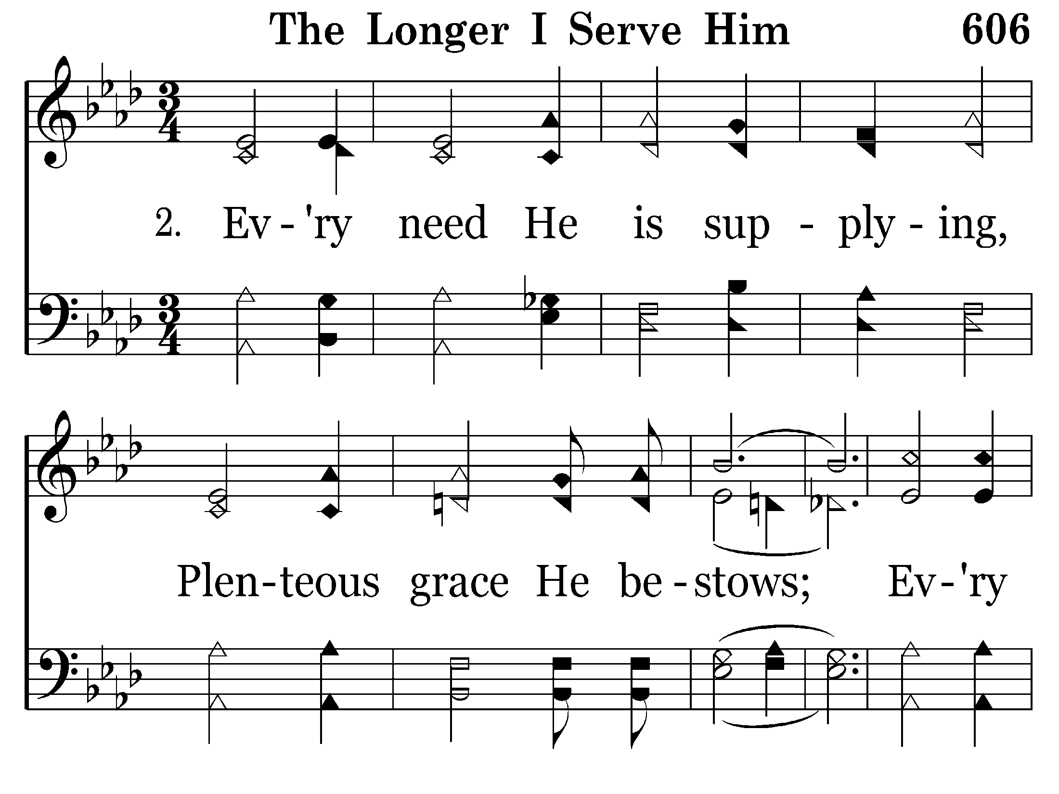

Slide 55
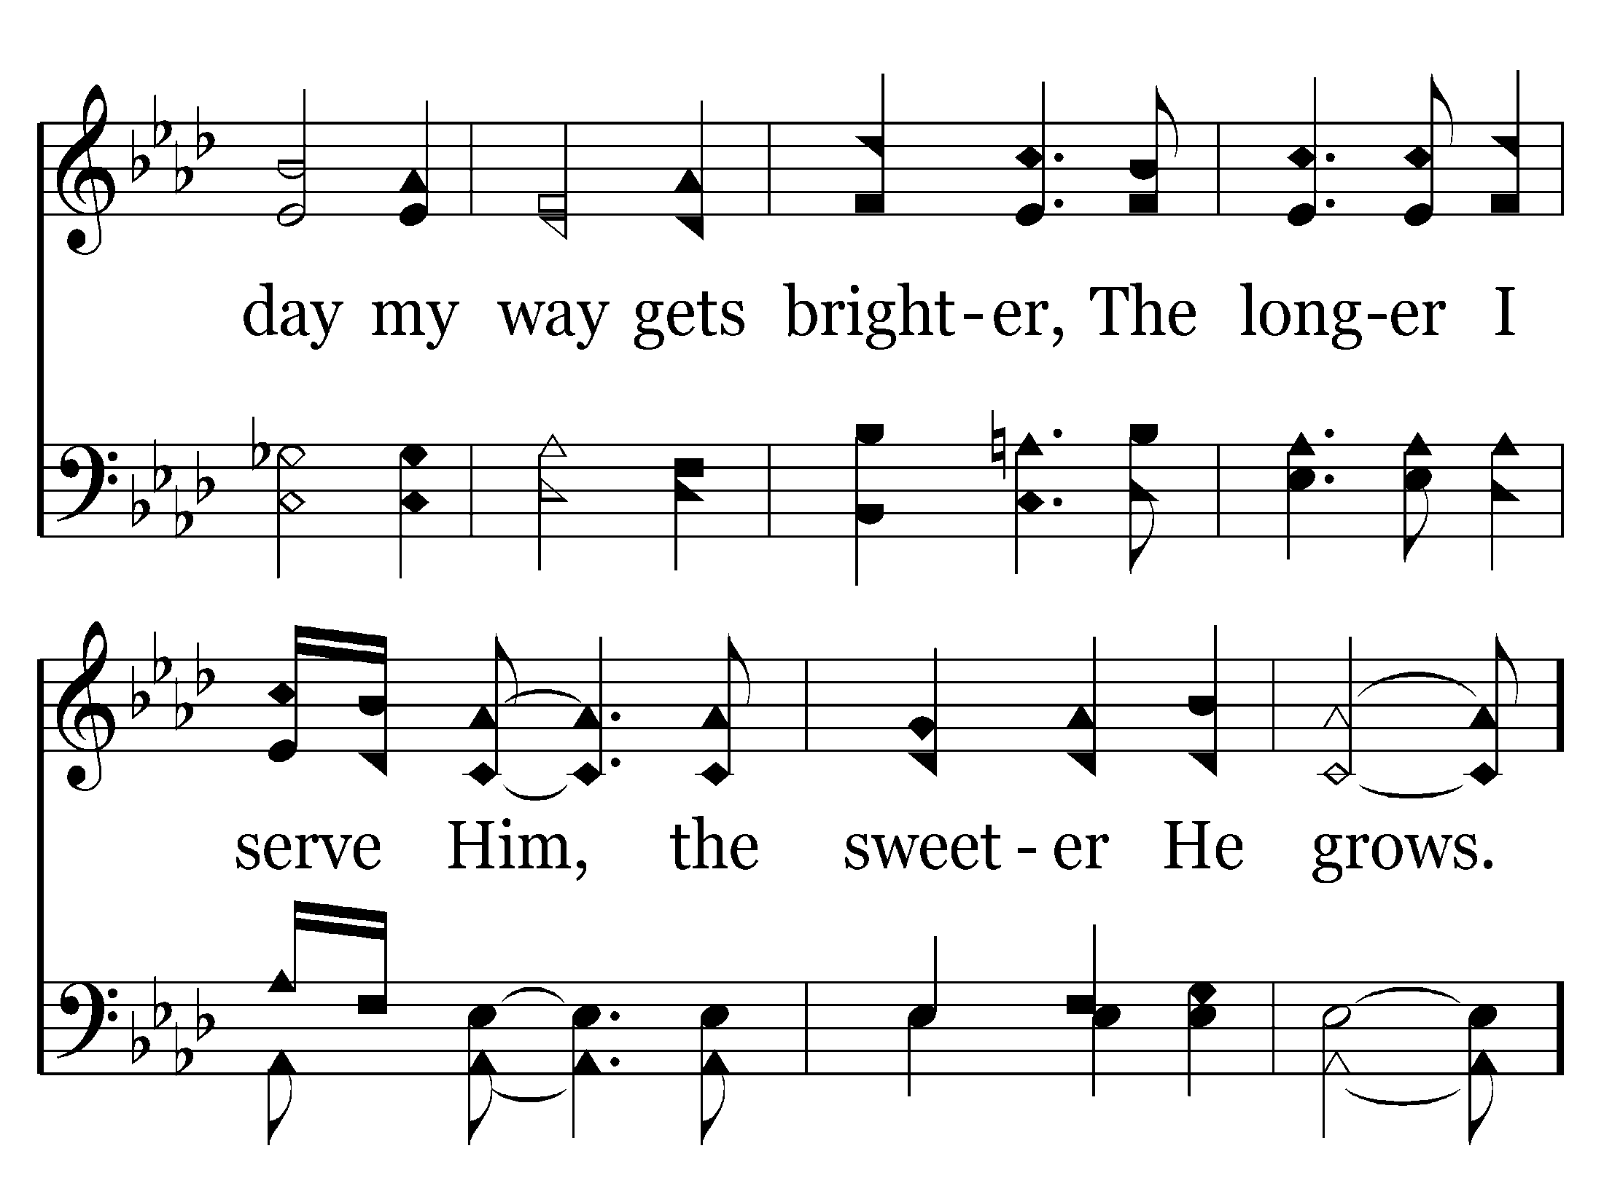

Slide 58
End of Song

Slide 60
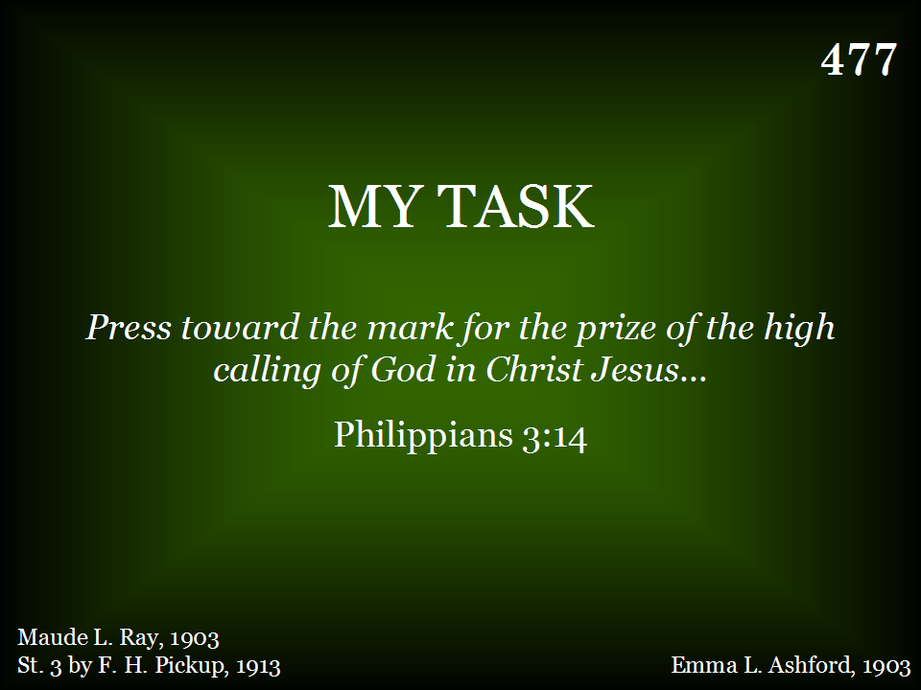

Slide 61
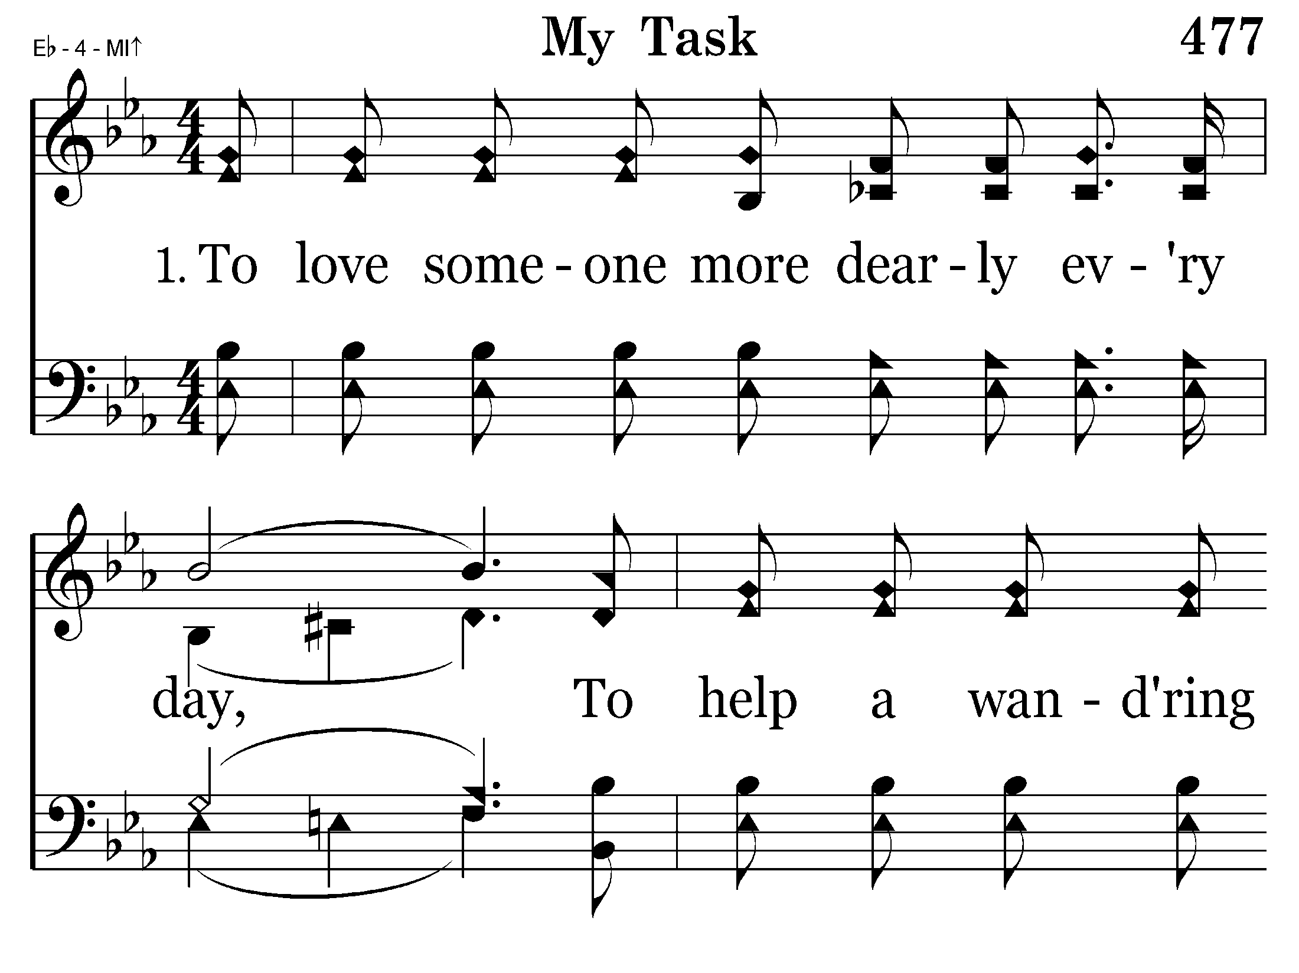

Slide 62
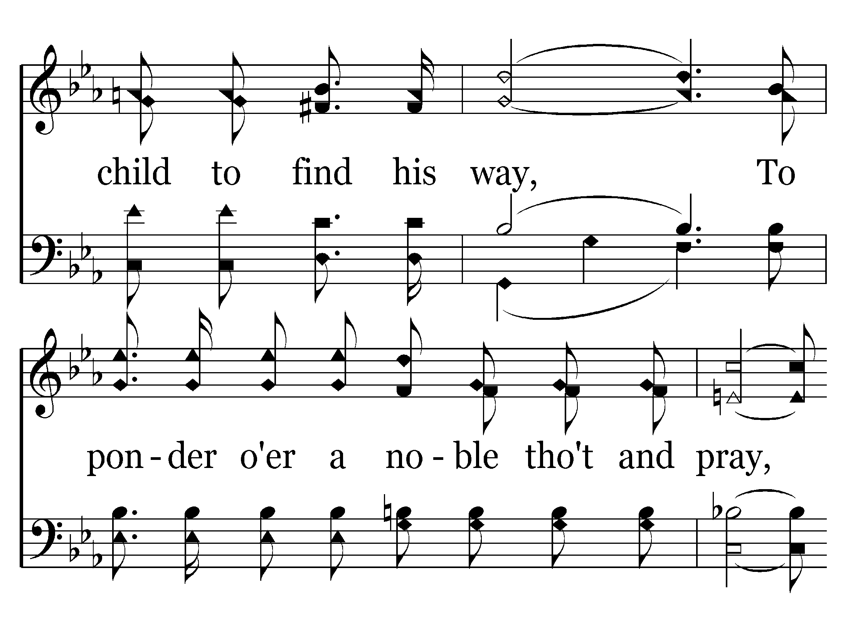

Slide 63
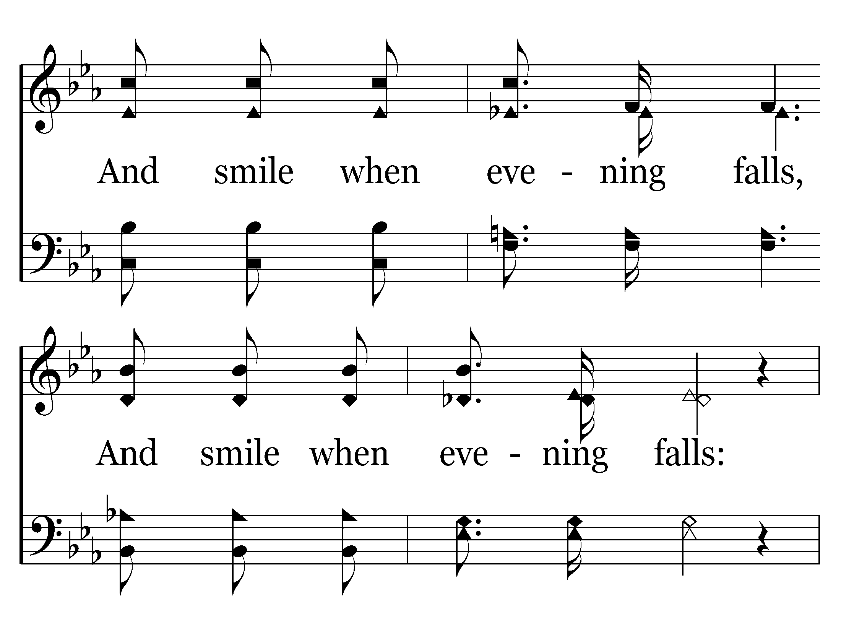

Slide 64
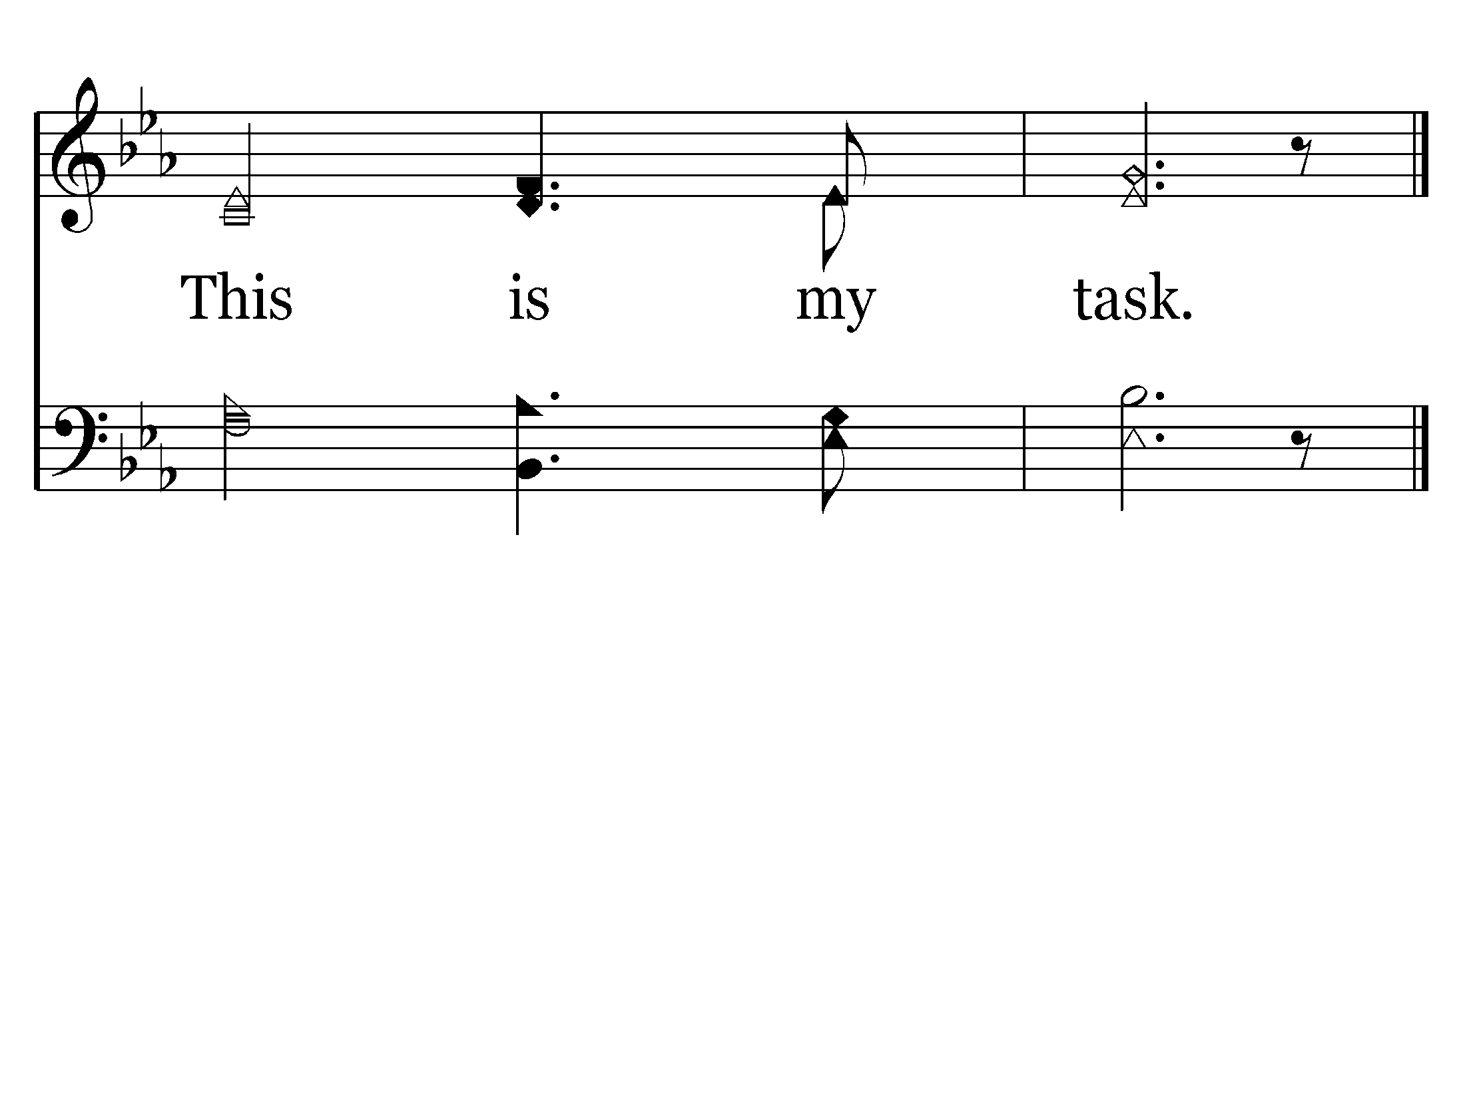
End of Song

Slide 66
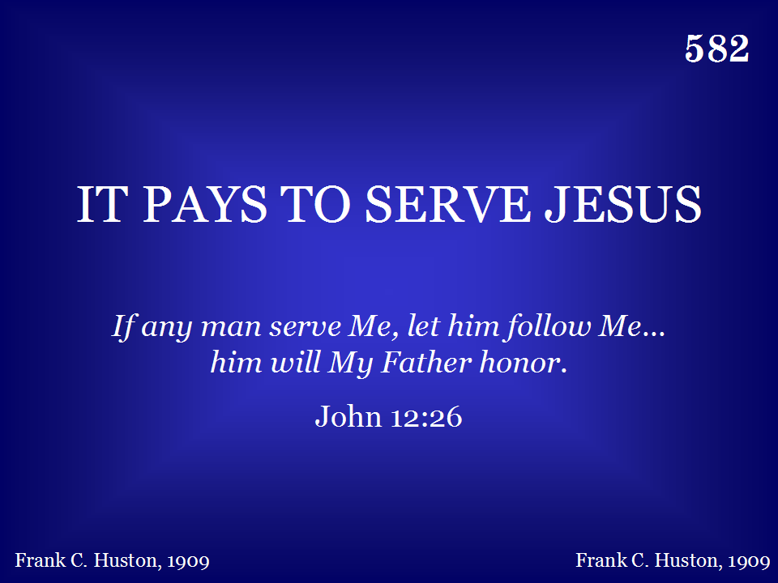

Slide 67
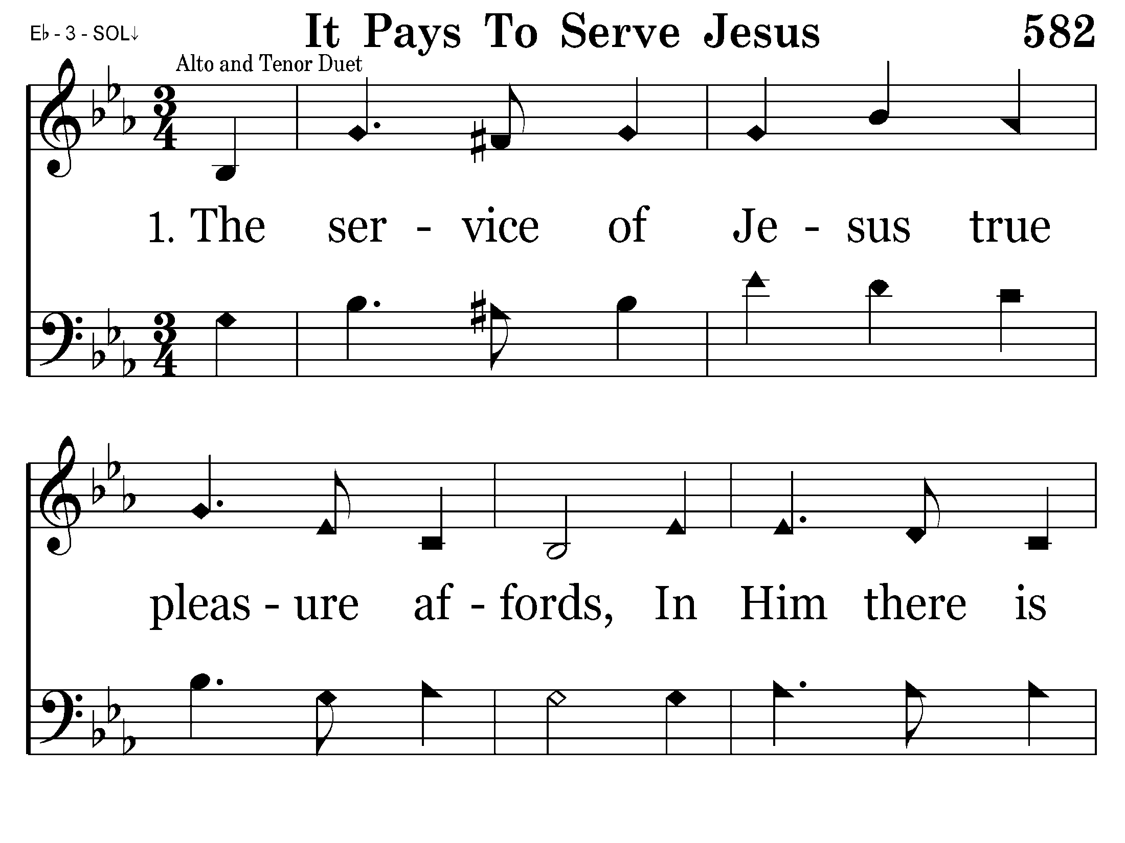

Slide 68
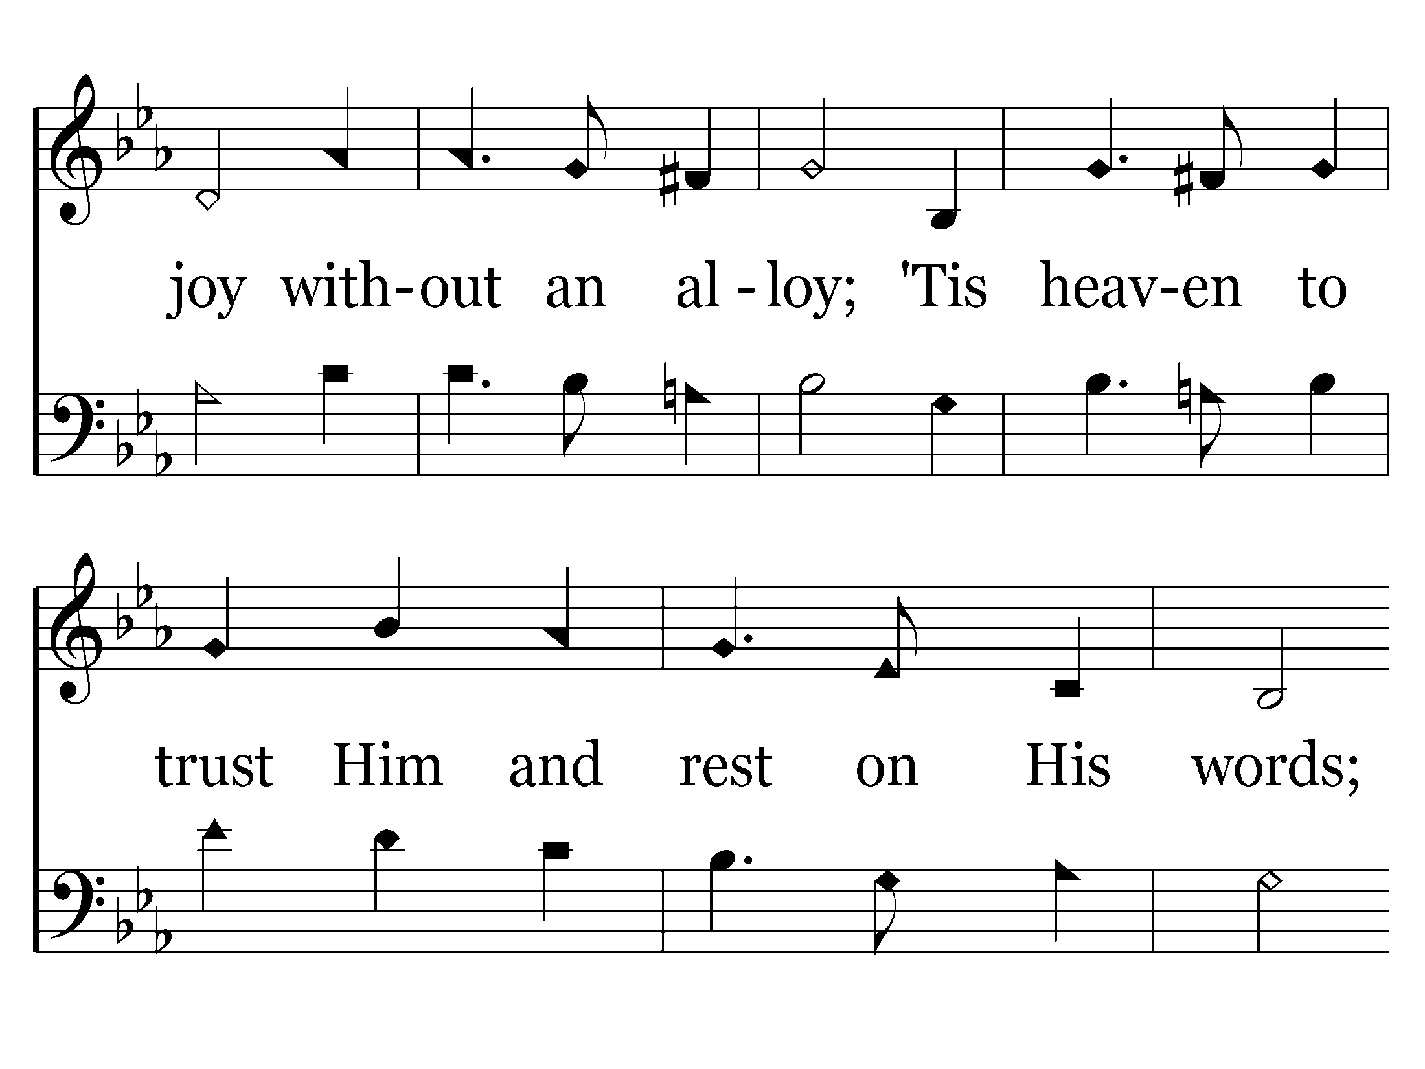

Slide 69
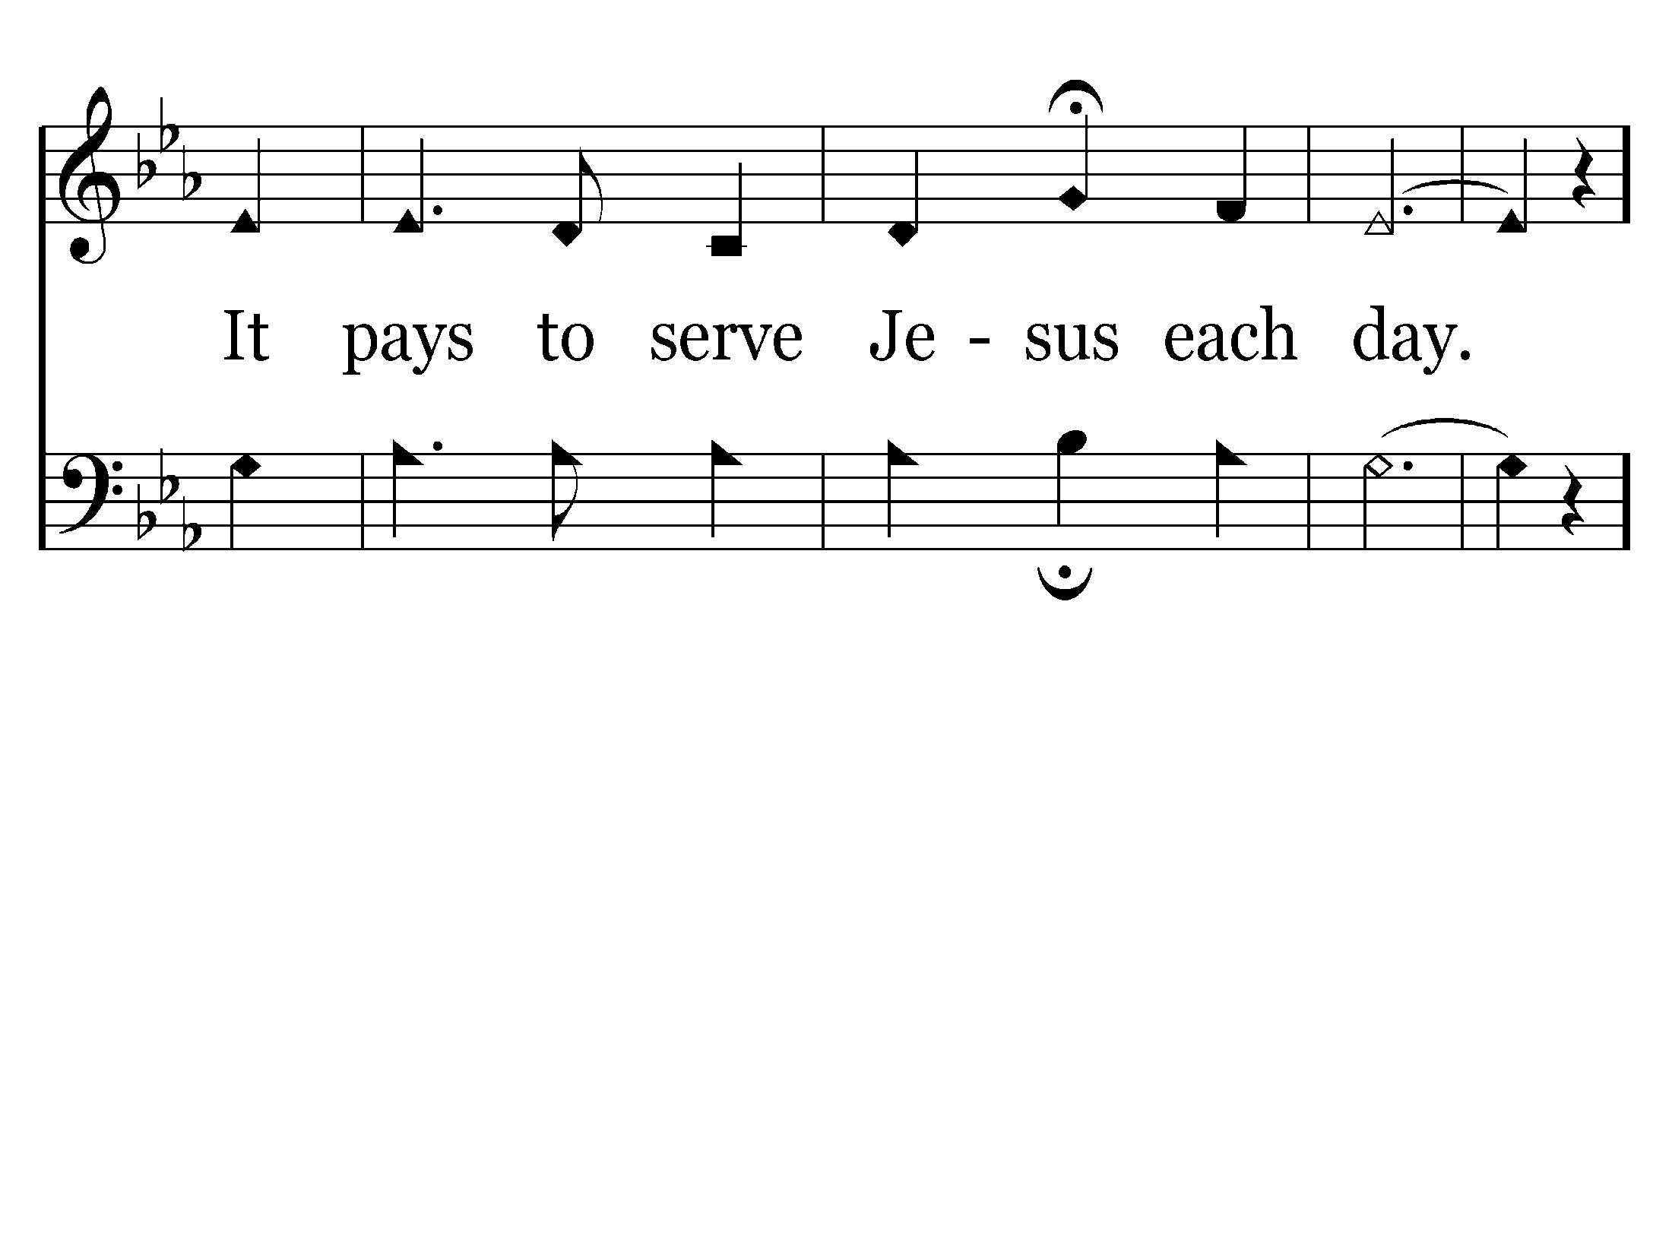
End of Verse 1

Slide 70
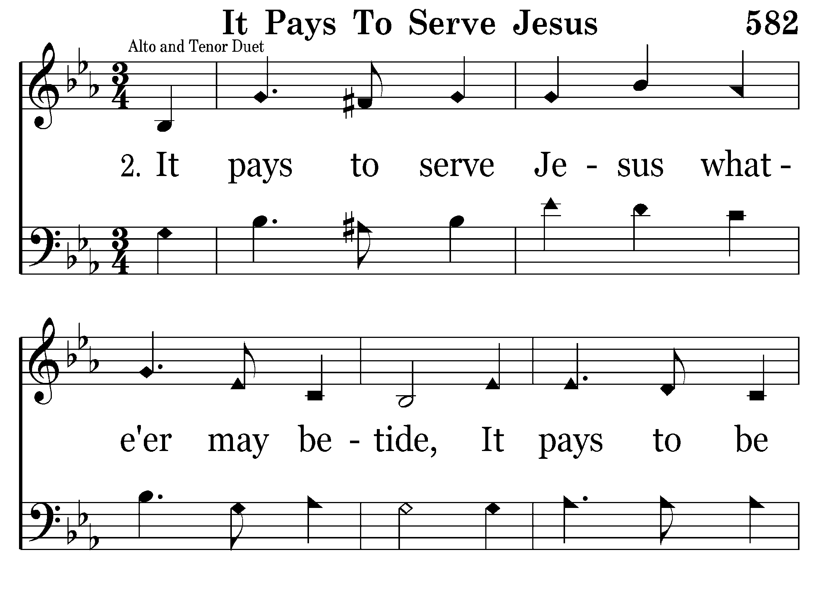

Slide 71
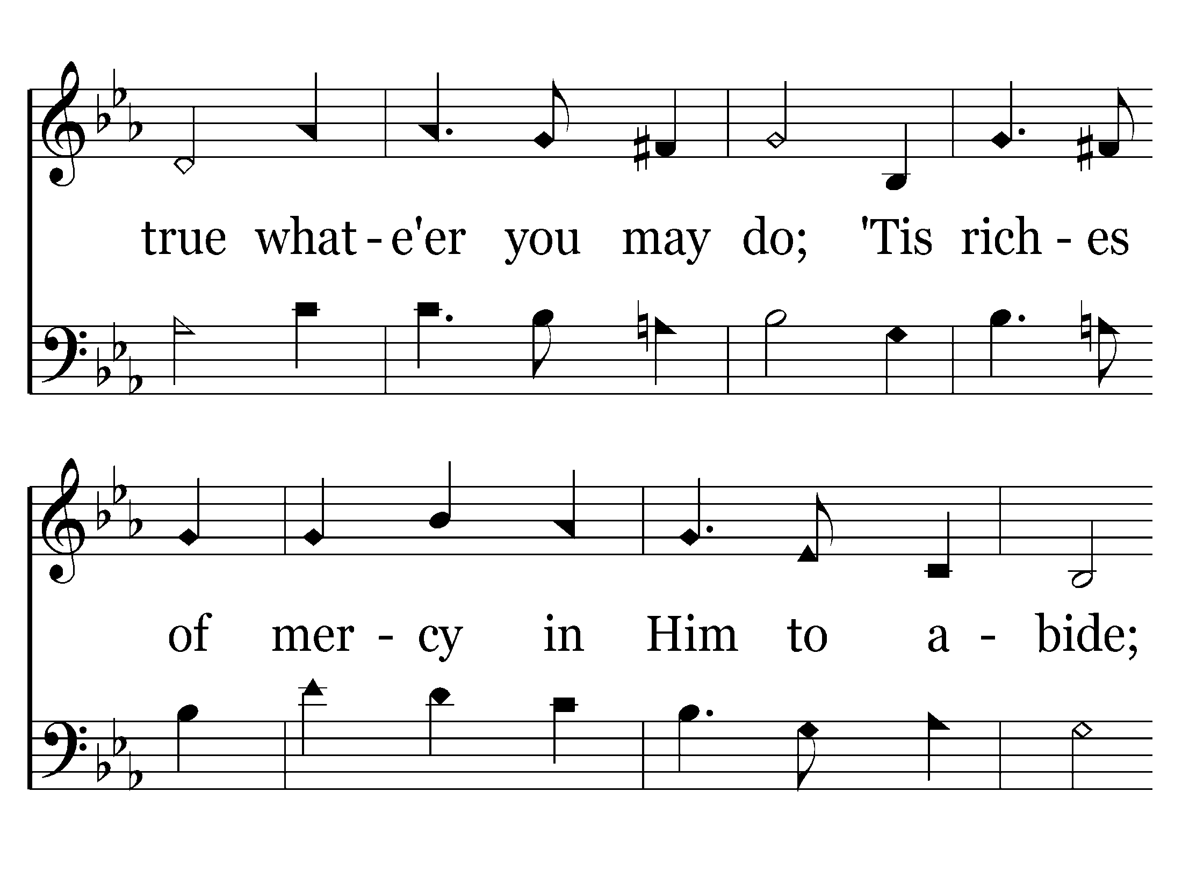

Slide 73
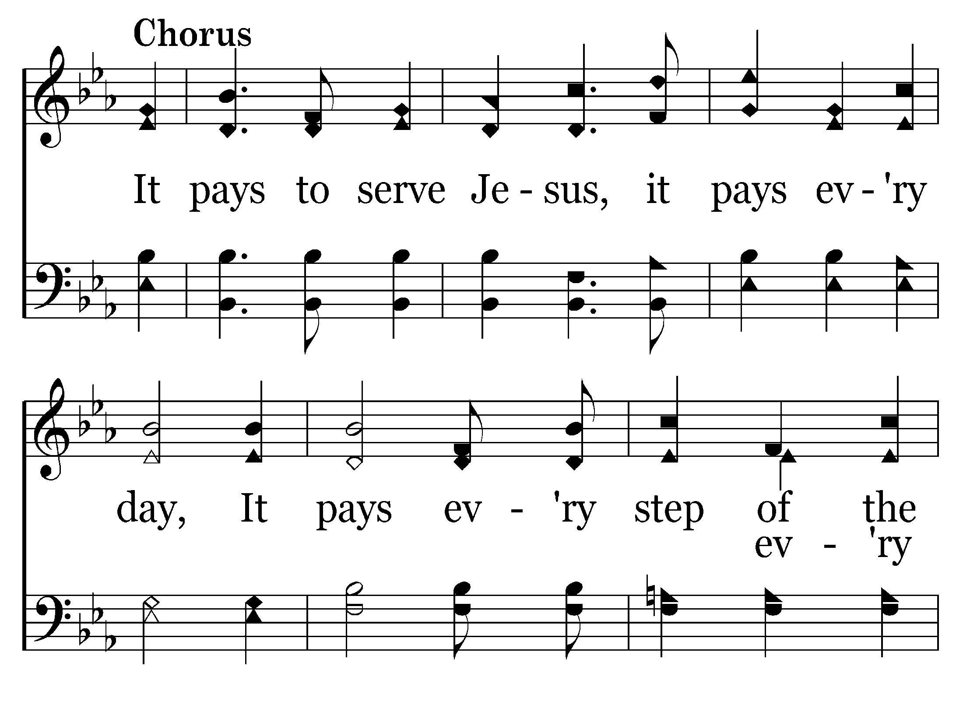

Slide 74
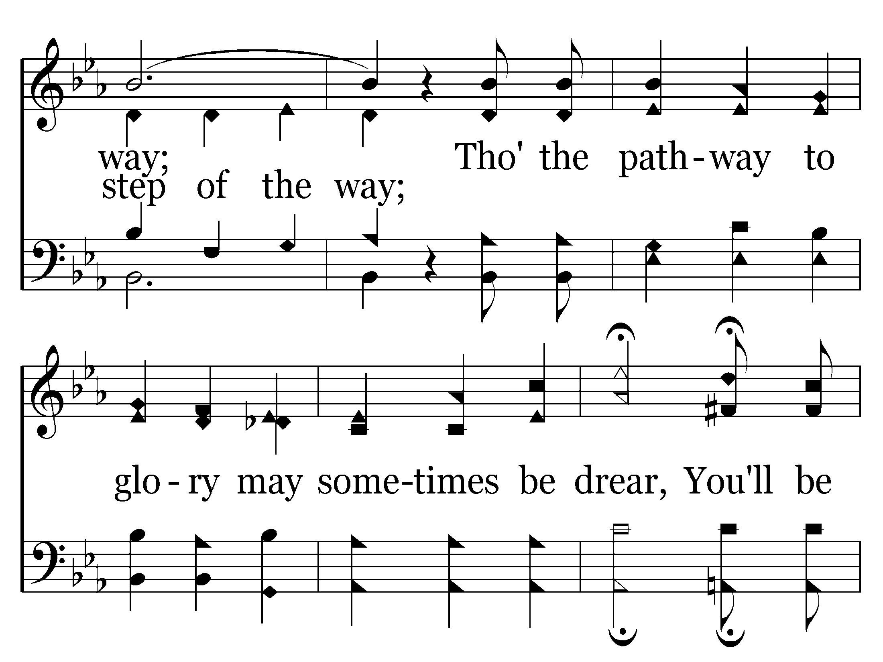

Slide 75

End of Song

Slide 76


Slide 77


Slide 78


Slide 79


Slide 80


Slide 81


Slide 82

End of Song

